Slide 1
TOBAGO WORKSHOP ON EDUCATIONAL ASSESSMENT THE CORE-FORMATIVE ASSESSMENT Days 5-8, Sessions 1 to 8
©JEROME DE LISLE, REAIG, 2013

Slide 2
Implementing Formative Assessment Practice in TOBAGO
Day 5: Introduction
Day 7: Promoting Assessment Conversations
Day 8: Formative Assessment Models
Day 6: Practice
Day 7: 21st Century Skills
THE TOBAGO INTERVENTION

Slide 3
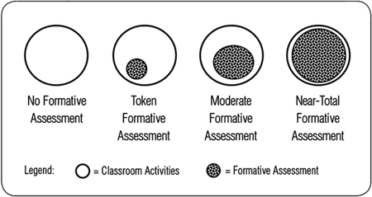
How much?

Slide 4
Day 5: Introducing Formative Assessment
PLENARY: ASSESSMENT FOR LEARNING/FORMATIVE ASSESSMENT / FORMATIVELY FOCUSED CONTINUOUS ASSESSMENT/FORMATIVE USE OF SUMMATIVE TESTS
TUTORIAL: UNDERSTANDING THE HISTORY, ROLE AND USE OF FORMATIVE ASSESSMENT
PLENARY: FORMATIVE ASSESSMENT MODELS-THE WORK OF WILIAM AND BLACK AND MARGARET HERITAGE
TUTORIALS: ANALYSING FORMATIVE ASSESSMENT TEACHER PRACTICE USING VIDEOS
VOLUNTARY AFTER WORKSHOP SESSION: WHY FORMATIVE ASSESSMENT IS IMPORTANT FOR IMPROVED ACHIEVEMENT IN TOBAGO IMPLEMENTING COMMON FORMATIVE ASSESSMENTS IN SCHOOLS

Slide 5
Day 6: Formative Assessment Practice
PLENARY: ASSESSMENT AS LEARNING?
TUTORIAL: IMPLEMENTING ASSESSMENT AS LEARNING IN TOBAGO CLASSROOMS-WHY CLASSROOMS AND TEACHING MUST CHANGE
PLENARY: THE FIRST STEP IN FORMATIVE ASSESSMENT-SHARING LEARNING INTENTIONS AND CRITERIA FOR SUCCESS IN FORMATIVE ASSESSMENT
TUTORIALS: THE WORK OF SHIRLEY CLARK IN THE UK ON SHARED LEARNING INTENTIONS/ANALYSIS OF VIDEOS OF THE PROCESS CO-CONSTRUCTING RUBRICS WITH STUDENTS LEARNING PROGRESSIONS
VOLUNTARY AFTER WORKSHOP SESSION: EXAMINING CHANGING POLICY ON ASSESSMENT IN THE CLASSROOM INTERNATIONALLY

Slide 6
Day 8: Formative Assessment Models
PLENARY: FORMATIVE FEEDBACK
TUTORIAL: HOW TO GIVE FORMATIVE FEEDBACK (ROLE PLAY)
PLENARY: THE ROLE OF PEER ASSESSMENT & PROMOTING SELF ASSESSMENT AND METACOGNITION
TUTORIALS: HOW TO ACTIVATE PEERS AS LEARNERS ENCOURAGING SELF ASSESSMENT IN THE CLASSROOM
VOLUNTARY AFTER WORKSHOP SESSION: ORGANIZING FOR PEER ASSESSMENT-EXAMPLES AND BEST PRACTICE

Slide 7
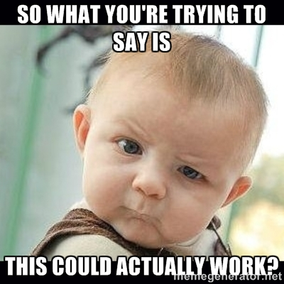
Review

Slide 8
On classroom assessment
Assessment in the classroom may be
formative (used to promote learning)
diagnostic (used to remediate)
summative (used to measure student learning).

Slide 9
Definitions
Formative Assessment is
A process in which data is collected on the degree to which students know or are able to do a given learning task, and which identifies the part of the task that the student does not know or is unable to do. Feedback as a part of the process is used to suggest future steps for teaching and learning.

Slide 10
Definitions
Summative Assessment
Is the process of making a judgment of student learning at the conclusion of a unit or units of instruction, or an activity or plan to determine student skills and knowledge, or the effectiveness of a plan, or an activity.

Slide 11
Assessments of, as, and for learning
Assessment FOR learning are formative & diagnostic assessments. Assessment FOR learning is the use of a task or an activity for determining student progress during a unit or block of instruction. Teachers are can adjust classroom instruction based upon the needs of the students and students are provided with valuable feedback on their own learning. Assessment OF learning is the use of a task or an activity to measure, record and report on a student's level of achievement in regards to specific learning expectations. These are often known as summative assessments. Assessment AS learning is the use of a task or an activity to allow students the opportunity to use assessment to further their own learning. Self and peer assessments allow students to reflect on their own learning and identify areas of strength and need. These tasks offer students the chance to set their own personal goals and advocate for their own learning.

Slide 12
On classroom assessment
The critical distinction between assessment “for” and “of” learning is the basis of much recent theory and research, with the emergence of assessment for learning (also called embedded assessment and assessment to promote learning) as the key lynch pin in reforming teaching, learning and assessment.

Slide 13
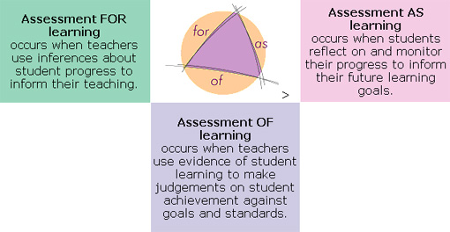

Slide 14
What is the difference between AFL & formative assessment?
Formative assessment may be regarded as the broader term and includes both assessment for learning and assessment as learning in self and peer assessment.
However, Stiggins considered AFL to be a form of formative assessment
We will consider the term formative assessment as equivalent to assessment for learning.

Slide 15
Start Now

Slide 16
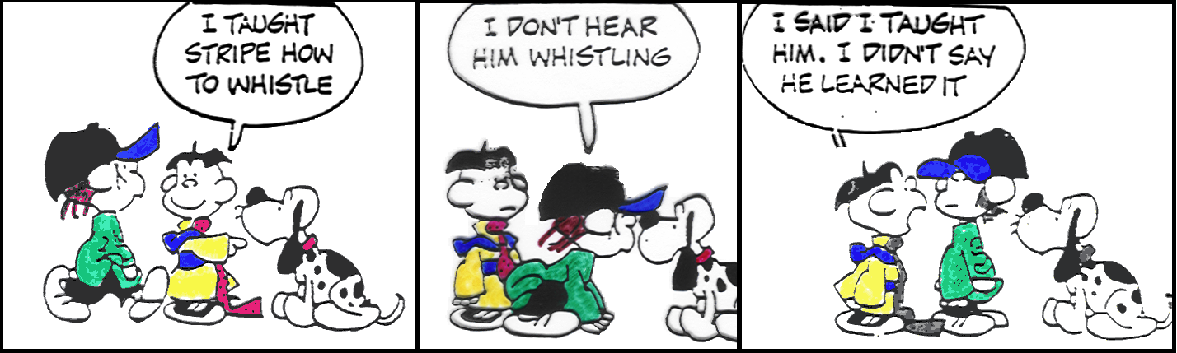

Slide 17
Connecting Performance to FORMATIVE Assessment
Authentic PA Task
Co-construction & Use of Rubrics
Formative Assessment during PA Task

Slide 18
Assessment of Learning- Is that what we are doing?
‘Assessment for Learning’ and ‘formative assessment’ are phrases widely used in educational discourse in the United States, Canada, New Zealand, Australia, the United Kingdom and Europe. A number of definitions, some originally generated by members of this Conference, are often referred to. However, the ways in which the words are interpreted and made manifest in educational policy and practice often reveal misunderstanding of the principles, and distortion of the practices, that the original ideals sought to promote. Some of these misunderstandings and challenges derive from residual ambiguity in the definitions.
Position Paper on Assessment for Learning from the Third International Conference on Assessment for Learning Dunedin, New Zealand, March 2009

Slide 19
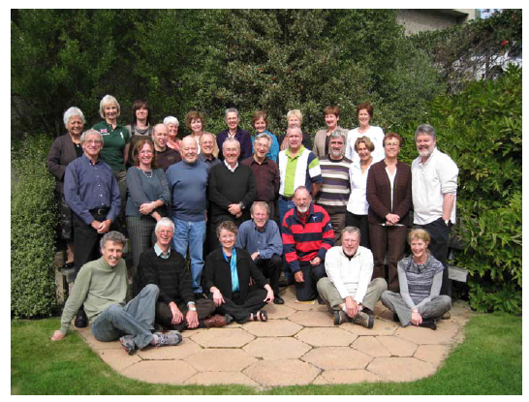
The participants pictured in this photograph taken on the last day of the conference are (left to right from back to front):Sandie Aitkin, New Zealand; Mary James, England; Mien Seger, Netherlands; Lorna Earl,Canada; Susan Brookhart, United States; Menucha Birenbaum, Israel; Carolyn Hutchison,Scotland; Ruth Sutton, England; Claire Wyatt-Smith, Australia; Alison Gilmore, NewZealand; Lester Flockhart, New Zealand; Mary Chamberlain, New Zealand; Filip Dochy, Belgium/Netherlands; Jim Popham, United States; Royce Sadler, Australia; Frank Philips,United States; Dany Laveault, Canada; Geoff Cainen, Canada; Richard Daugherty, Wales;Val Klenowski,; Australia; Ann Longston, Canada; Jeffrey Smith, New Zealand; PeterJohnston, United States; Terry Crooks, New Zealand; Anne Davies, Canada; Gordon Stobart,England; Ken O’Connor, Canada; Rick Stiggins, United States; Kari Smith, Norway. Teammembers not in photograph: Linda Allal, Switzerland; Linda Darling Hammond, UnitedStates; John Hattie, New Zealand; Juliette Mendelovits, Australia; Lisa Smith, New Zealand

Slide 20
Box 3: Four working definitions of formative assessment endorsed by the 2009 position paper on assessment for learning.
‘Assessment for Learning is the process of seeking and interpreting evidence for use by learners and their teachers to decide where the learners are in their learning, where they need to go and how best to get there’.
Assessment Reform Group (2002)
‘Practice in a classroom is formative to the extent that evidence about student achievement is elicited, interpreted, and used by teachers, learners, or their peers, to make decisions about the next steps in instruction that are likely to be better, or better founded, than the decisions they would have taken in the absence of the evidence that was elicited’.
Black & Wiliam (2009).
‘Formative assessment is a process used by teachers and students during instruction that provides feedback to adjust ongoing teaching and learning to improve students’ achievement of intended instructional outcomes.’
McManus (2008).
‘Formative assessment is a planned process in which assessment-elicited evidence of students’ status is used by teachers to adjust their ongoing instructional procedures or by students to adjust their current learning tactics.’
Popham (2008).

Slide 21

A moment of reflection Discuss Each Definition and its Implications

Slide 22
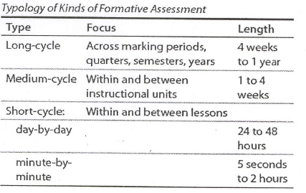

Slide 23
Models of Formative Assessment

Slide 24
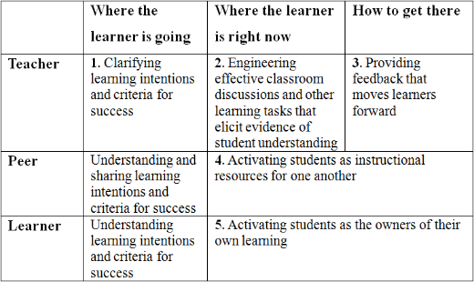
A theory of formative assessment

Slide 25
7 Step Model
Where am I Going?
1. Provide students with a clear and understandable vision of the learning target.
2. Use examples and models of strong and weak work.
Where am I Now?
3. Offer regular descriptive feedback.
4. Teach students to self assess and set goals.
How Can I Close the Gap?
5. Design lessons to focus on one learning target or aspect of quality at a time.
6. Teach students focused revision.
7. Engage students in self-reflection and let them keep track of and share their learning.

Slide 26
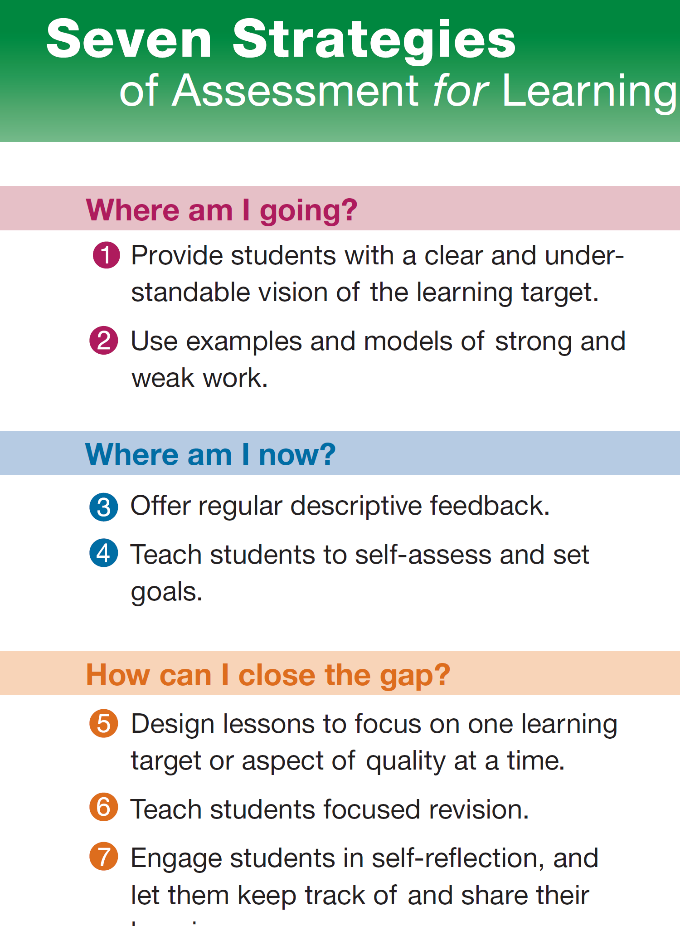

Slide 27
Tuttle (2009)
Pre-assessing students
Sharing learning goals with students
Sharing or co-creating of learning criteria with students
Employing quality classroom discourse and questioning
Using rich and challenging tasks that elicit students’ responses
Identifying the gap between where the students are now and the desired standard goal
Providing feedback that helps students identify how to improve
Using self-assessment and peer assessment
Providing students with opportunities to close the gap between current and desired performance
Celebrating learning progressions

Slide 28
Sample Chunk- Insects are important in the ecosystem
Share Learning Intentions/ Assess what students know in discussion
Co-construct rubric on Field Trip/Observation Journal/Exhibition
Discuss what an insect is
Discuss the variety of insects in different habitats/Watch Video
Discuss adaptability of insects/Insects living with us (in human homes)
Participate in Field Trip-Assignment
Choose insect to study in Detail-Exhibition
Present Journals/Celebrate Progression

Slide 30
What are Learning Progressions?
Learning progressions
describe in words and examples what it means to move over time toward more expert understanding of some big idea or topic.
depict successively more sophisticated ways of thinking about an idea that might reasonably follow one another as students learn.
have been referred to by many different names, including progress variables, learning trajectories, progressions of developmental competence, and profile strands.

Slide 31
Learning Progressions inform Assessment
Learning progressions inform assessment in the following cycle
Translate the big ideas assessment tasks or activities suitable for classroom settings through which students can demonstrate their understanding of big ideas and practices.
Use student performances to develop clusters of assessment tasks or items, including both traditional and nontraditional items.
Use as a basis for rubrics to interpret student responses, explaining how responses reveal students’ thinking with respect to big ideas and learning progressions.

Slide 32
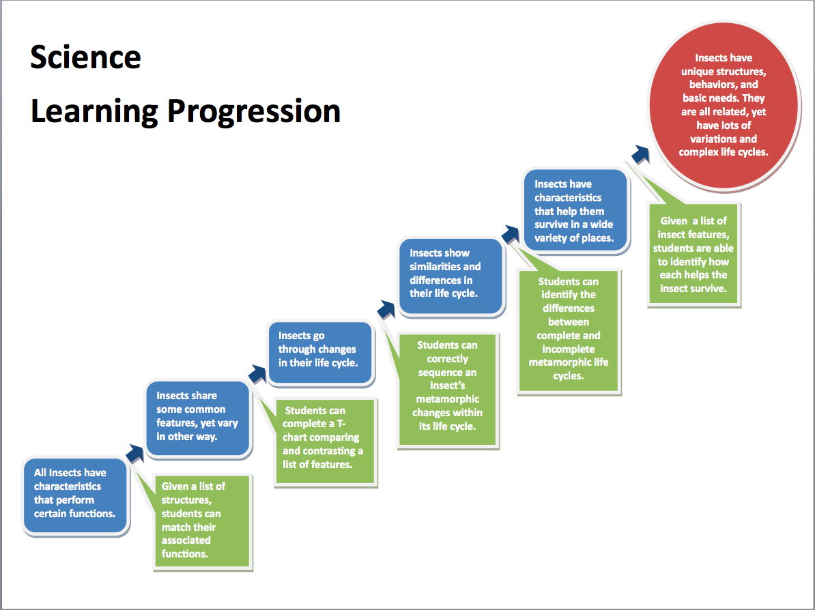

Slide 33

Part 2-Everything about feedback

Slide 34
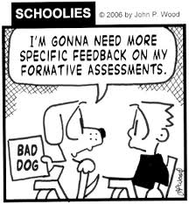

Slide 35
What is Feedback?
Basically, feedback is information about how we are doing in our efforts to reach a goal
feedback is not comments made after the fact, including advice, praise, and evaluation.
Whether feedback is just there to be grasped or is provided by another person, helpful feedback is goal-referenced; tangible and transparent; actionable; user-friendly (specific and personalized); timely; ongoing; and consistent.

Slide 36
Feedback-What & When
Feedback in an assessment for learning context occurs while there is still time to take action.
It functions as a global positioning system, offering descriptive information about the work, product, or performance relative to the intended learning goals.
It is not focused solely on marks or comments that judge the level of achievement or imply that the learning journey is over.

Slide 37


Slide 38
More on Feedback
Effective descriptive feedback
focuses on the intended learning, identifies specific strengths
points to areas needing improvement
suggests a route of action students can take to close the gap between where they are now and where they need to be
takes into account the amount of corrective feedback the learner can act on at one time
models the kind of thinking students will engage in when they self-assess.

Slide 39
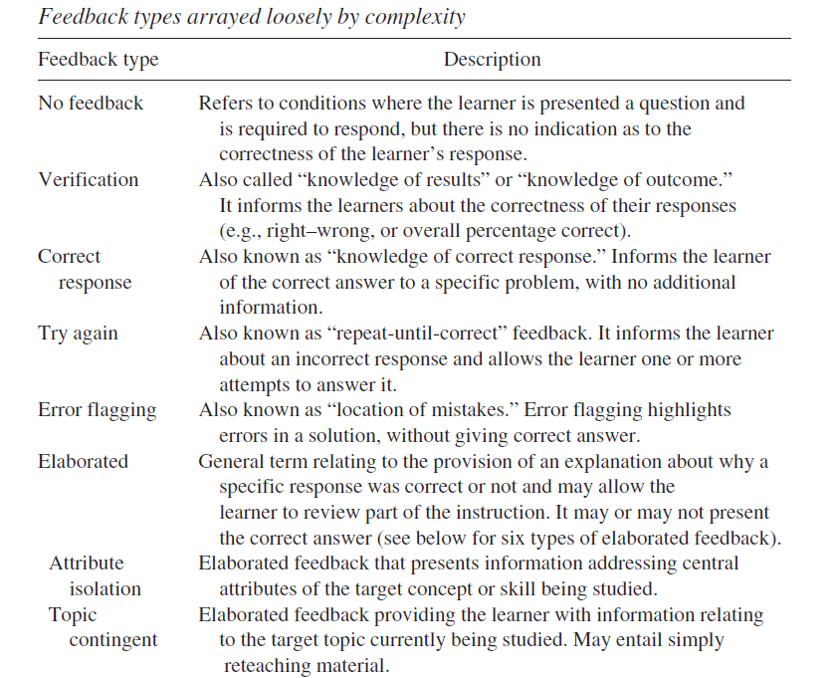

Slide 40
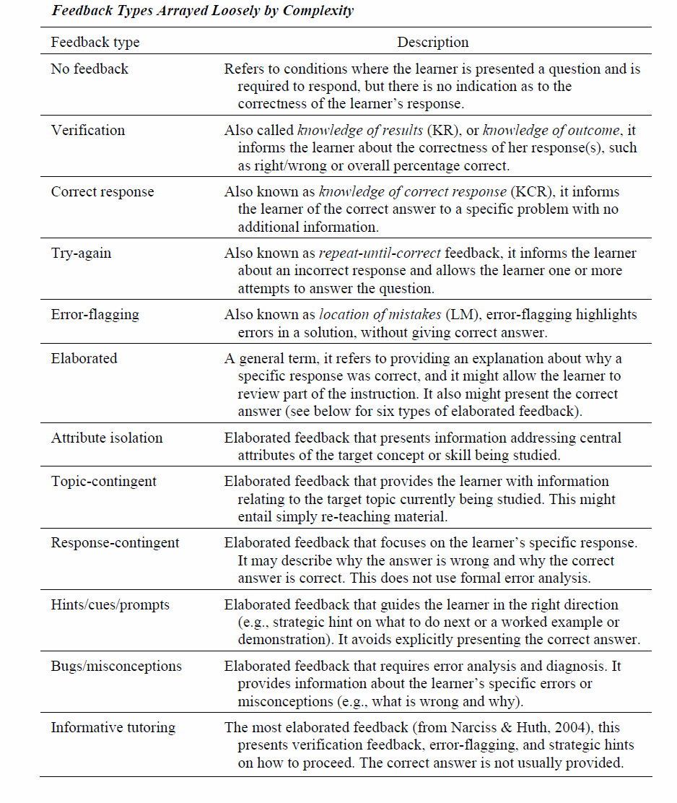

Slide 41
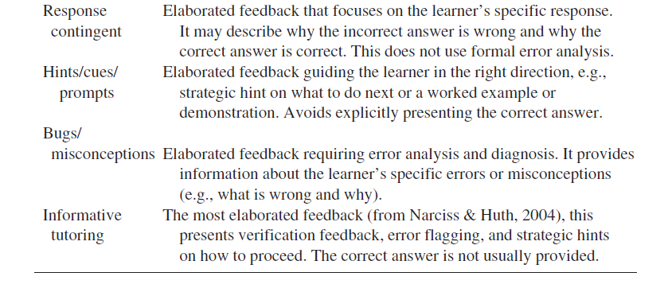

Slide 42
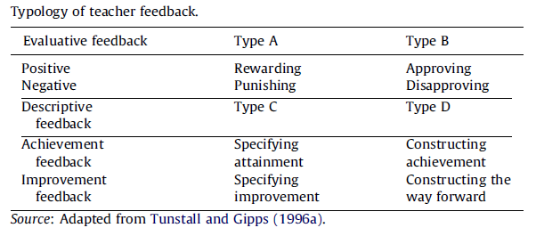
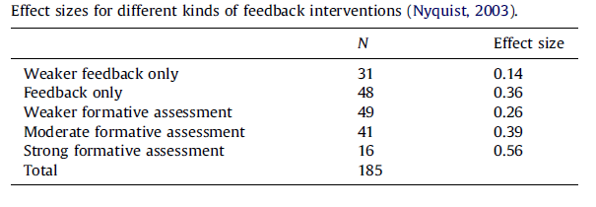

Slide 43
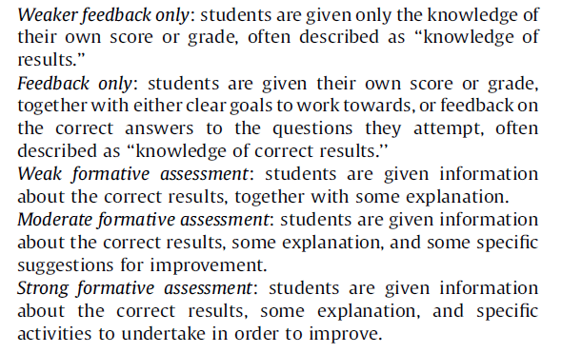
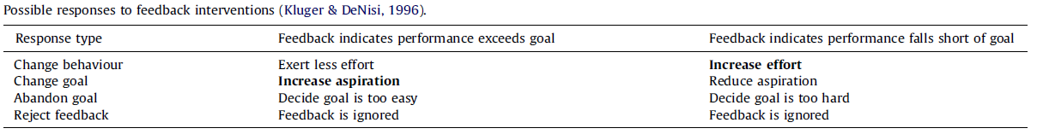

Slide 44
Feedback vs. Advice ›You need more examples in your report.› You might want to use a lighter baseball bat.› You should have included some Essential Questions in your unit plan. These three statements are not feedback; they're advice. Such advice out of the blue seems at best tangential and at worst unhelpful and annoying. Unless it is preceded by descriptive feedback, the natural response of the performer is to wonder, "Why are you suggesting this?“ As coaches, teachers, and parents, we too often jump right to advice without first ensuring that the learner has sought, grasped, and tentatively accepted the feedback on which the advice is based. By doing so, we often unwittingly end up unnerving learners. Students become increasingly insecure about their own judgment and dependent on the advice of experts—and therefore in a panic about what to do when varied advice comes from different people or no advice is available at all. If your ratio of advice to feedback is too high, try asking the learner, "Given the feedback, do you have some ideas about how to improve?" This approach will build greater autonomy and confidence over the long haul. Once they are no longer rank novices, performers can often self-advise if asked to.

Slide 45
Feedback vs. Evaluation and Grades › Good work!› This is a weak paper.› You got a C on your presentation.› I'm so pleased by your poster! These comments make a value judgment. They rate, evaluate, praise, or criticize what was done. There is little or no feedback here—no actionable information about what occurred. As performers, we only know that someone else placed a high or low value on what we did. How might we recast these comments to be useful feedback? Tip: Always add a mental colon after each statement of value. For example,• "Good work: Your use of words was more precise in this paper than in the last one, and I saw the scenes clearly in my mind's eye."• "This is a weak paper: Almost from the first sentence, I was confused as to your initial thesis and the evidence you provide for it. In the second paragraph you propose a different thesis, and in the third paragraph you don't offer evidence, just beliefs. "You'll soon find that you can drop the evaluative language; it serves no useful function. The most ubiquitous form of evaluation, grading, is so much a part of the school landscape that we easily overlook its utter uselessness as actionable feedback. Grades are here to stay, no doubt—but that doesn't mean we should rely on them as a major source of feedback.

Slide 46
Practicing Feedback

Slide 47
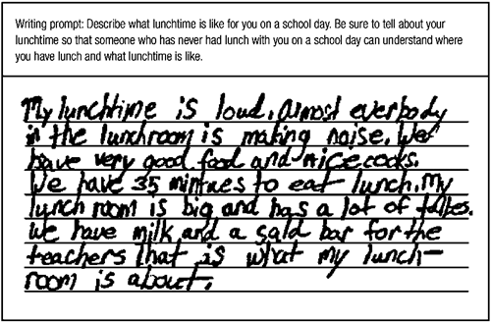

Slide 48
As part of a unit on how to write effective paragraphs, a 4th grade teacher assigned her students to write a paragraph answering the question, "Do dogs or cats make better pets?" They were asked to have a clear topic sentence, a clear concluding sentence, and at least three supporting details. A student named Anna wrote and got teacher feedback on the paragraph

Slide 49
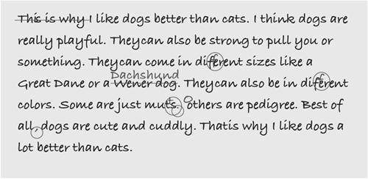

Slide 50
An initial feedback comment might be this:
This is clear and makes sense to me.
This comment describes the positive features of the work in relation to the learning goal: clarity and meaning in writing. The next bit of feedback might be this:
More details would make this more interesting. If you move the sentence about the lunchroom being big right after "noise," you give one reason for the noise. Can you think of others? Can you describe what the noise sounds like?
For some students, it would be advisable to stop here, with one positive comment and one suggestion for improvement. For students who are interested in further work on the goal of adding more details, the following comment would also help:
Can you give some examples of the "good food" besides milk and salad for the teachers? What kinds of food do you eat at lunch? What foods do your friends eat?

Slide 51
Possible Teacher Comments | What's Best About This Feedback
Your topic sentence and concluding sentence are clear and go together well. | These comments describe achievement in terms of the criteria for the assignment. They show the student that you noticed these specific features and connected them to the criteria for good work.
You used a lot of details. I count seven different things you like about dogs.
Your paragraph makes me wonder if you have a dog who is playful, strong, cute, and cuddly. Did you think about your own dog to write your paragraph? When you write about things you know, the writing often sounds real like this. | This comment would be especially useful for a student who had not previously been successful with the writing process. The comment identifies the strategy the student has used for writing and affirms that it was a good one. Note that "the writing often sounds genuine" might be better English, but "real" is probably clearer for this 4th grader.
Your reasons are all about dogs. Readers would already have to know what cats are like. They wouldn't know from your paragraph whether cats are playful, for instance. When you compare two things, write about both of the things you are comparing. | This constructive feedback criticizes a specific feature of the work, explains the reason for the criticism, and suggests what to do about it.
Did you check your spelling? See if you can find two misspelled words. | These comments about style and mechanics do not directly reflect the learning target, which was about paragraphing. However, they concern important writing skills. Their appropriateness would depend on how strongly spelling, style/usage, and word choice figure into the longer-term learning targets.
Feedback about making the topic sentence a stronger lead might best be done as a demonstration. In conference, show the student the topic sentence with and without "This is why" and ask which sentence she thinks reads more smoothly and why. Ask whether "This is why" adds anything that the sentence needs. You might point out that these words read better in the concluding sentence.

Slide 52
Feedback Models

Slide 53
Feedback Model 1- Hattie & Timperley, 2007
Key Questions are
Where am I going?
How am I going?
Where to next?

Slide 54
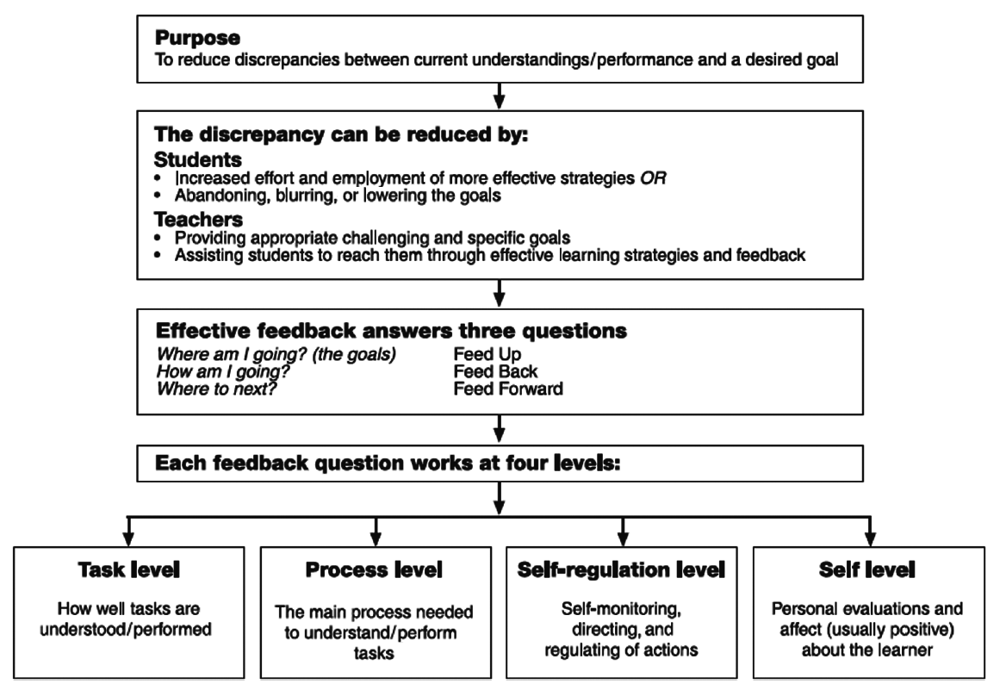

Slide 55
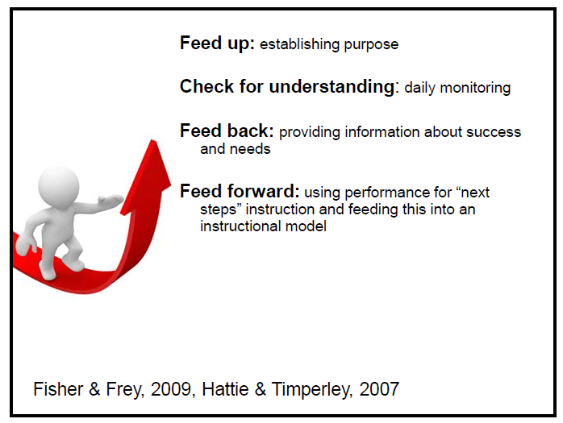
Feedback Model 2- Fisher & Frey 2009

Slide 56
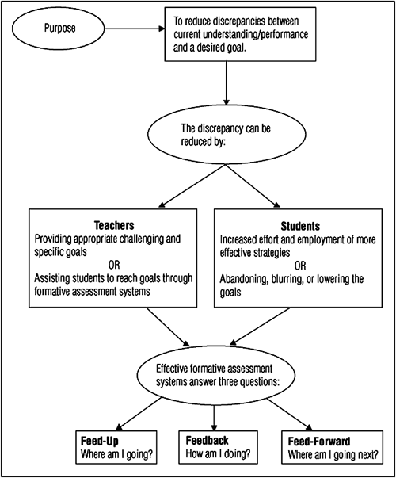

Slide 57
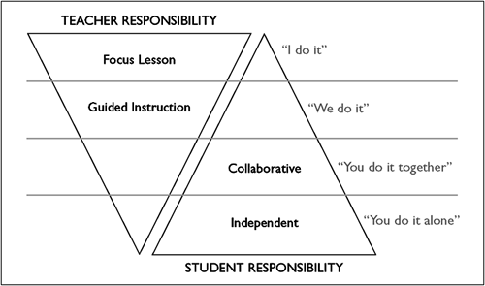

Slide 58
Understanding Feedback

Slide 59
Types of Feedback
(1) feedback about the task (such as feedback about whether answers were right or wrong or directions to get more information)
(2) feedback about the processing of the task (such as feedback about strategies used or strategies that could be used)
(3) feedback about self-regulation (such as feedback about student self-evaluation or self-confidence)
(4) feedback about the student as a person (such as pronouncements that a student is "good" or "smart")

Slide 60
Feedback Strategies
Timing
Amount
Mode
Audience

Slide 61
Feedback Strategies Can Vary In … | In These Ways … | Recommendations for Good Feedback
Timing | When given How often | Provide immediate feedback for knowledge of facts (right/wrong). Delay feedback slightly for more comprehensive reviews of student thinking and processing. Never delay feedback beyond when it would make a difference to students. Provide feedback as often as is practical, for all major assignments.

Slide 62
Feedback Strategies Can Vary In … | In These Ways … | Recommendations for Good Feedback
Amount | How many points made How much about each point | Prioritize—pick the most important points. Choose points that relate to major learning goals. Consider the student's developmental level.

Slide 63
Feedback Strategies Can Vary In … | In These Ways … | Recommendations for Good Feedback
Mode | Oral Written Visual/demonstration | Select the best mode for the message. Would a comment in passing the student's desk suffice? Is a conference needed? Interactive feedback (talking with the student) is best when possible. Give written feedback on written work or on assignment cover sheets. Use demonstration if "how to do something" is an issue or if the student needs an example.

Slide 64
Feedback Strategies Can Vary In … | In These Ways … | Recommendations for Good Feedback
Audience | Individual Group/class | Individual feedback says, "The teacher values my learning." Group/class feedback works if most of the class missed the same concept on an assignment, which presents an opportunity for reteaching.

Slide 65
Feedback on what? (content)
Focus
Comparison
Function
Valence
Clarity
Specificity
Tone

Slide 66
Feedback Content Can Vary In … | In These Ways … | Recommendations for Good Feedback
Focus | On the work itself On the process the student used to do the work On the student's self-regulation On the student personally | When possible, describe both the work and the process—and their relationship. Comment on the student's self-regulation if the comment will foster self-efficacy. Avoid personal comments.

Slide 67
Feedback Content Can Vary In … | In These Ways … | Recommendations for Good Feedback
Comparison | To criteria for good work (criterion-referenced) To other students (norm-referenced) To student's own past performance (self-referenced) | Use criterion-referenced feedback for giving information about the work itself. Use norm-referenced feedback for giving information about student processes or effort. Use self-referenced feedback for unsuccessful learners who need to see the progress they are making, not how far they are from the goal.

Slide 68
Feedback Content Can Vary In … | In These Ways … | Recommendations for Good Feedback
Function | Description Evaluation/ judgment | Describe. Don't judge.
Valence | Positive Negative | Use positive comments that describe what is well done. Accompany negative descriptions of the work with positive suggestions for improvement.
Clarity | Clear to the student Unclear | Use vocabulary and concepts the student will understand. Tailor the amount and content of feedback to the student's developmental level.

Slide 69
Feedback Content Can Vary In … | In These Ways … | Recommendations for Good Feedback
Specificity | Nitpicky Just right Overly general | Tailor the degree of specificity to the student and the task. Make feedback specific enough so that students know what to do but not so specific that it's done for them. Identify errors or types of errors, but avoid correcting every one (e.g., copyediting or supplying right answers), which doesn't leave students anything to do.
Tone | Implications What the student will "hear" | Choose words that communicate respect for the student and the work. Choose words that position the student as the agent. Choose words that cause students to think or wonder.

Slide 70
DAY 7: ASSESSMENT CONVERSATIONS & ASSESSING 21ST CENTURY SKILLS
PLENARY: CLASSROOM DISCOURSE AND QUESTIONING: INFORMAL/INTERACTIVE FORMATIVE ASSESSMENT
TUTORIAL: HOW TO HAVE ASSESSMENT CONVERSATIONS IN THE CLASSROOM-INFORMAL FORMATIVE ASSESSMENT PRACTICE
PLENARY: DEVELOPING COGNITIVELY CHALLENGING TASKS ASSESSING 21ST CENTURY SKILLS FOCUSING UPON AUTHENTIC TASKS
TUTORIALS: USING AUTHENTIC PERFORMANCE ASSESSMENTS TO DRIVE THE SCHOOL SYSTEM
VOLUNTARY AFTER WORKSHOP SESSION: ORGANIZING FOR FORMATIVE ASSESSMENT

Slide 71
On Assessment Conversations
Assessment Conversations are the daily instructional dialogues that embed assessment into an activity already occurring in the classroom.
You can use assessment conversations in informal formative assessment to promote learning as you engage in teaching-learning.
Questions are the guide to gathering evidence of student learning.

Slide 72
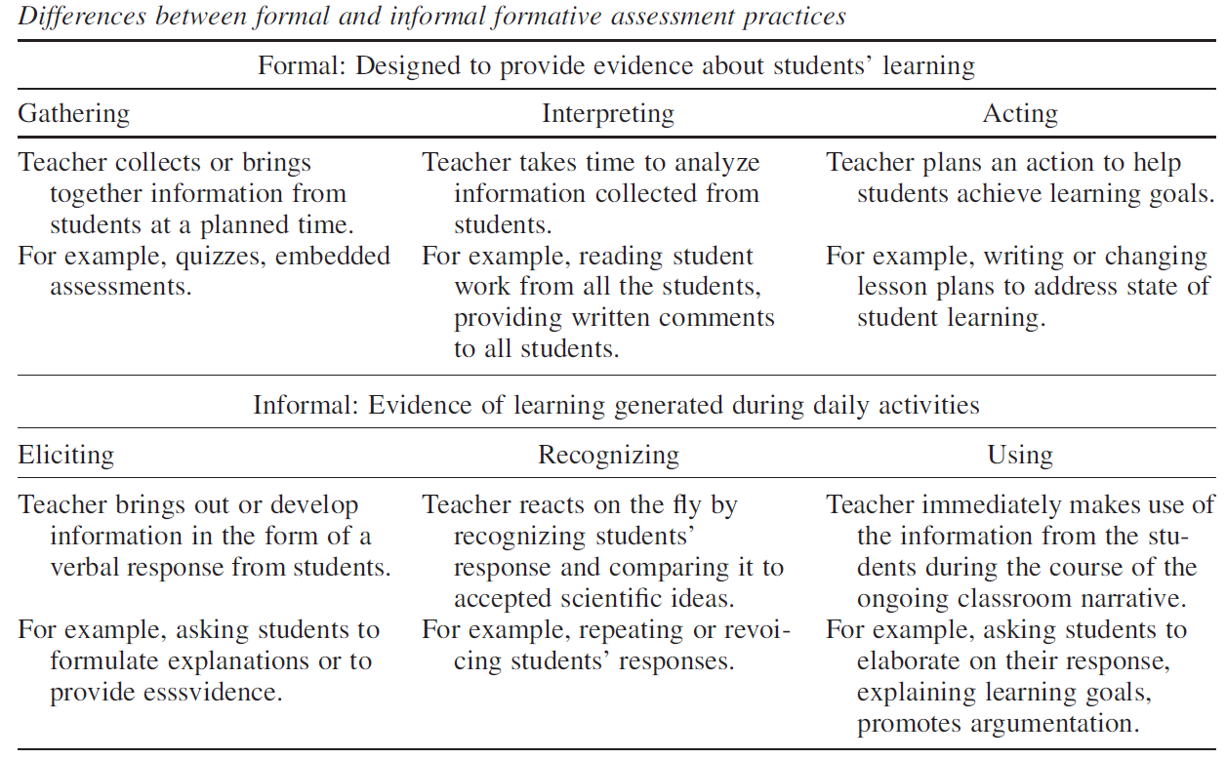
Informal vs formal formative assessment

Slide 73
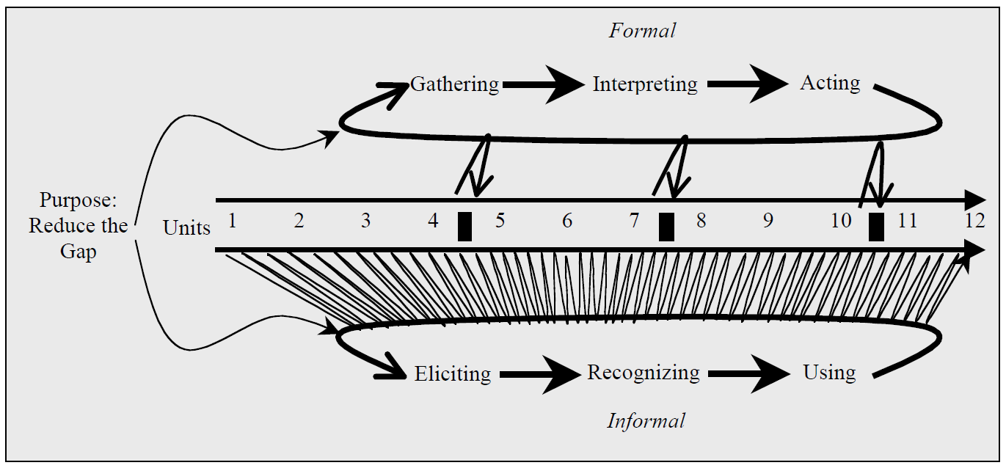

Slide 74
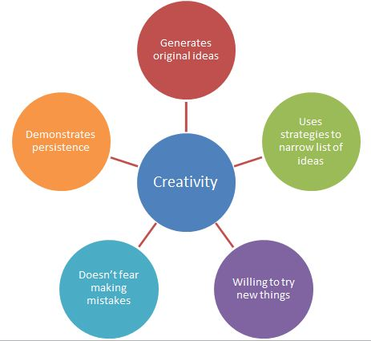
Assessing 21st century Skills

Slide 75
What are 21st Century Skills?
The 21st century skills are a set of abilities and competencies that students need to develop in order to succeed as adults and continuing learners in the information age (21st Century).

Slide 76
Several Frameworks
There is no agreed list and several frameworks are available and promoted. What do you think is important for Tobago?

Slide 77
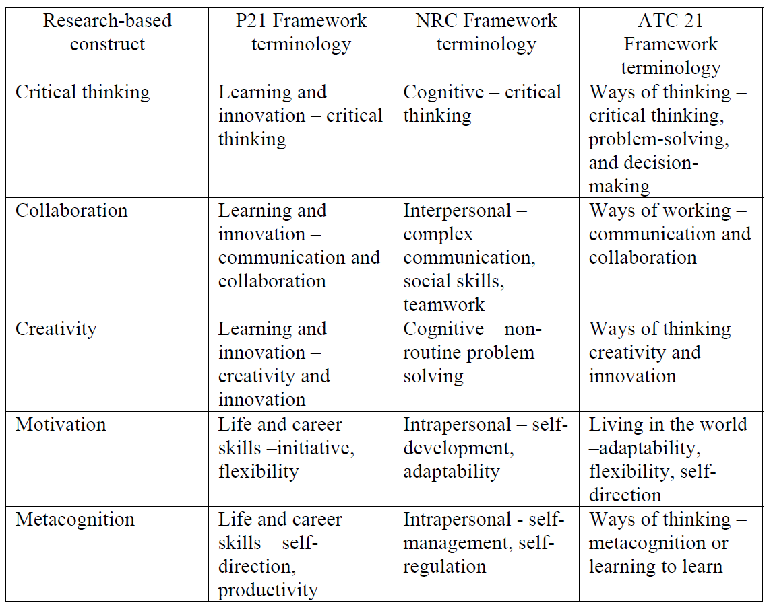

Slide 78
Assessment & 21st Century Skills
Assessment as Learning where the student has a central role and is engaged in self assessment is a key tool in ensuring that students are learning to learn.
One of the key outcomes we would expect is metacognitive skill

Slide 79
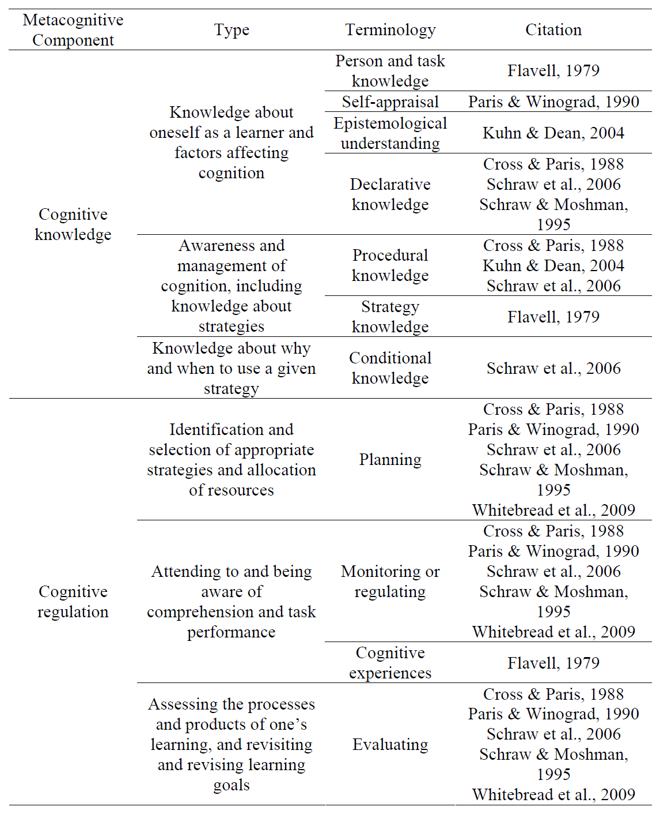

Slide 80
Assessing 21st Century Skills
These might be fostered and assessed during performance based activities.
Use rubrics to provide tutor, peer and self assessment feedback

Slide 81
