Slide 1
TOBAGO WORKSHOP ON EDUCATIONAL ASSESSMENT Day 1, Session 2
©JEROME DE LISLE, REAIG, 2013

Slide 2
DAY 1: INTRODUCTION TO ASSESSMENT
PLENARY: DEFINITIONS & MEANINGS OF ASSESSMENT AND ASSESSMENT RELATED CONSTRUCTS/VIDEOS-OBSERVING ASSESSMENT
SURVEY/FEEDBACK: WHAT IS MY ASSESSMENT LITERACY-R
PLENARY: FORMATS & PURPOSES OF ASSESSMENT/THE ASSESSMENT CYCLE
TUTORIALS: THE FIRST STEP IN THE ASSESSMENT CYCLE-HOW TO PLAN FOR A TEST/LEADING ASSESSMENTS IN SCHOOLS
VOLUNTARY AFTER WORKSHOP SESSION: TEST PLANNING

Slide 3
The process of assessing
Evidence
Judgment
Decision
Inference

Slide 4
Evidence, assessment design, & choices
The decisions we make from an assessment are never sacrosanct. As captured by the model they depend upon the quality of evidence gathered, the appropriateness of our inferences and our own skill in making judgments.
From this perspective the assessment literacy of teachers becomes critical to good assessment. Assessment literacy is demonstrated in the choices we make in assessment.
Should we sample once or more than once if the assessment is to lead to a high stakes decision?
Should we use a performance assessment or a multiple choice given the specific purpose of the assessment as certifying learning at the end of the unit?

Slide 5

CHOICES

Slide 6
On choices
There are different choices in the way we design and use assessments- We must choose wisely.
The choices we make are critical to validity and to the consequences of test use.
All assessment is fallible to the extent that the design process and the expected responses do not follow the agreed model.
All choices reflect cultural values and an understanding of learning and knowledge.

Slide 7
Choosing Purpose
The multiple purposes of assessment may be grouped into three main categories
Promoting and Supporting Learning
Monitoring & Accountability
Selecting & Certifying Students
Purpose number 3 should not dominate the system and might be considered as useful at selected points in the development cycle of students.
Although assessments for multiple purposes like the CPEA and SEA/CAC combination are quite common (even worldwide), questions remain when high stakes are attached to these multiple uses and purposes.

Slide 8
Choosing Formats
No format is inherently better than another. Simply attaching label like authentic, alternative or performance to an assessment, does not mean that the assessment simulates real life experience and promotes or supports learning.
Moreover, even traditional assessments may be authentic or used to provide feedback.
Some people believe that multiple choice items encourage guessing and cannot be used for testing higher order learning objectives. However, this is not true.

Slide 10
Assessment formats
There are three categories of assessment formats:
Assessment Format Examples
Selected Response MCQs
Constructed Response SAQs, Essays
Performance Assessments Portfolios, Projects

Slide 11
Each format category represents a family of items
The selected response family includes the multiple choice and matching item sets. There are several additional new designs such as extended matching items.
The constructed response family may vary from restricted formats such as fill in the blanks to extended formats such as essays.
The performance category includes a range of innovative formats such as posters, portfolios, exhibitions, and journals.
Computer Based Testing have added to the range of new and innovative item types used in testing.

Slide 14


Slide 15
Examples
Learn to understand each category by studying samples of items. Items may use some form of stimulus like a picture or data. These items are context dependent or figural (if a picture)

Slide 16
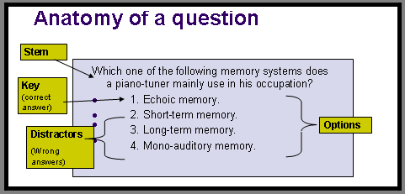
Simple MCQ

Slide 19
Figural CR
Stimulust
Keywordt
Promptt

Slide 20
Sample Performance Assessment
Sample performance task (grades 4-5)
Materials: Pattern blocks, paper, and colored pencils or crayons
Directions:
If the area of the green triangle is one square unit, find the area of the blue rhombus, the red trapezoid, and the yellow hexagon.
Use your pattern blocks to create two different designs with an area that is exactly 15 square units. Draw your patterns on the paper provided.
Write three observations about each of your designs.

Slide 21
Sample (Continued)
Sample rubric for this task:
Points Performance
5 The student correctly determines that the area of the blue rhombus is two square units, the area of the red trapezoid is three square units, and the area of the yellow hexagon is six square units. The two designs have an area of exactly 15 square units, and the student's observations use correct geometric terms.
4 One of the areas is incorrect or the student uses a geometric term incorrectly.
3 Two or three mistakes are made in determining areas or using geometric terminology.
2 Four mistakes are made in determining areas or using geometric terminology.
1 Five or more mistakes are made in determining areas or using geometric terminology.
0 No work is shown or the work is not on task.

Slide 22
Definitions
Ensure that you distinguish clearly between each type of assessment format by reviewing the formal definitions.

Slide 23
Selected Response
A Selected Response Question is an objective test item in which the student select the response. The item consists of a stem (either a question or an incomplete statement) and keyed responses (a selection of answers from which to choose) but usually only answer is correct. Examples include Multiple-Choice, True-False, and Matching.

Slide 24
Constructed Response
A Constructed-Response Item (also called Free Response) is a test question or task that requires the test-taker to create his or her own answer or response. Examples are completion, fill-in the blanks, short answer and essay questions.
The length of the written response may be as short as a single word or mathematical expression, in which case the question acquires some of the characteristics of the multiple-choice type.

Slide 25
Performance Assessment
A performance assessment is a task in which the student's active generation of a response is observable either directly or indirectly via a permanent product. The task is more often that not authentic, but to a degree in the sense that the nature and context in which the assessment occurs is relevant and represents "real world" problems or issues.

Slide 26
The Assessment Cycle
Constructing items and tasks is only one part of the assessment cycle. There are other steps or stages that contribute to the validity and utility of the assessment process.
For large scale assessments, 13 steps and 5 stages may be identified. We can apply the four stages to classroom assessment.

Slide 27
What is the assessment cycle?
The Assessment Cycle
Design
Development
Administration
Scoring
Test score use & interpretation

Slide 28
TEST DEVELOPMENT for large scale assessment
Construct Overall Plan
Establish Content & Domain Definitions
Format Test Specifications
Engage in Item Development
Test Design & Assembly
Test Production
Test Administration
Scoring Test Responses
Standard Setting
Score Reporting
Item Banking
Writing Technical Report
Making Decisions based on data

Slide 29
Planning Assessments
A useful tool for planning tests is a table of specifications which link the objectives or outcomes with the levels of thinking or student response desired.
Formats vary but the most common in traditional systems (MC- dominated) is the matrix type table with content versus domain. The domains may be represented by Bloom’s Taxonomy, however, other arrangements are possible and even advisable.
Performance Assessments often use the different outcomes or skills expected instead of the domains and the tasks or sub-tasks rather than the content.

Slide 30
Advice on constructing a table of specifications

Slide 31
Specifying the Cognitive Domain
The table of specifications is a useful tool in item generation because it can reduce the tendency of writers to construct low level questions for written papers.
There should also be significant planning for performance assessments.

Slide 32
Specifying the Cognitive Domain
There is no need to use Bloom’s taxonomy exclusively in specifying the cognitive domain,
There are multiple classifications, the best (most widely applicable) being the three component – knowledge, comprehension, and problem-solving

Slide 33
Specifying the Cognitive Domain
The problem-solving- category (Strategic and extended thinking) better represents reality because it is difficult to distinguish tasks that elicit higher order skills (above application)
See Haladyna (2004)
Example next

Slide 35
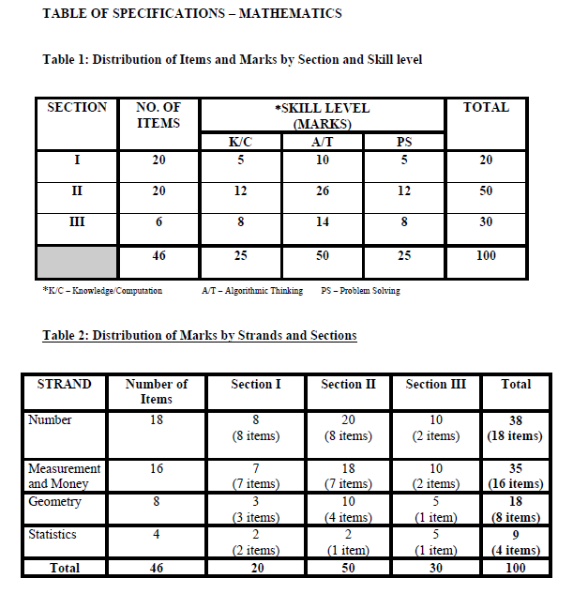
SEA Sample
Domain
Content

Slide 36
Just Samples

Slide 37
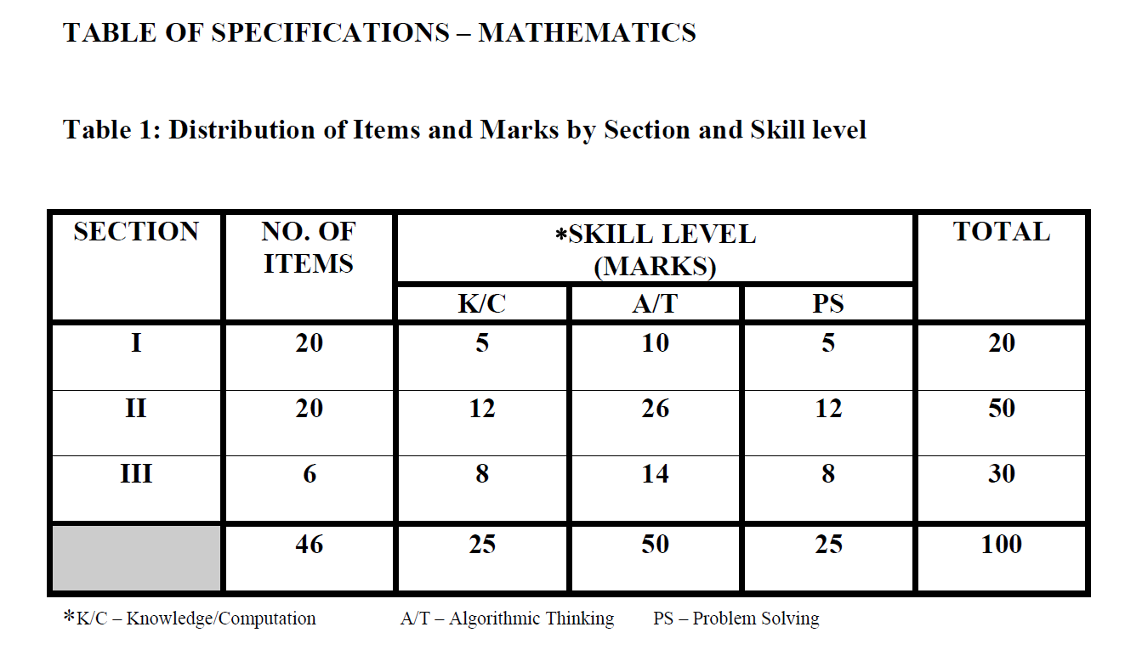
SEA Sample

Slide 38
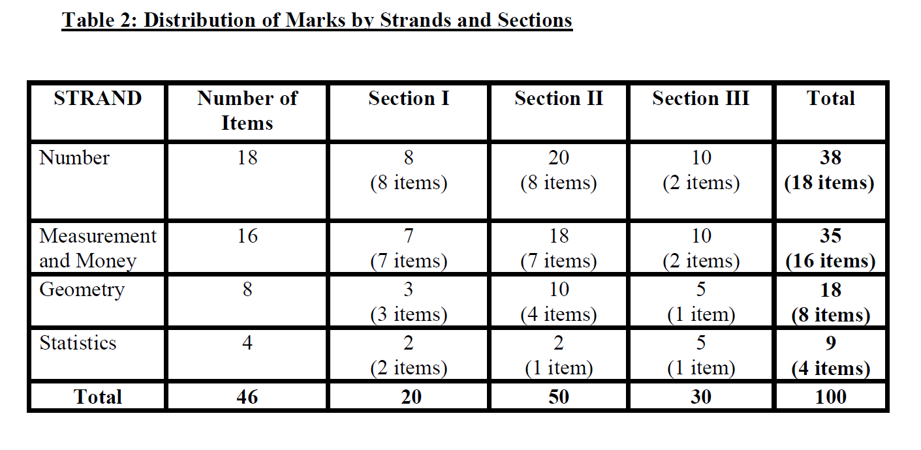

Slide 39
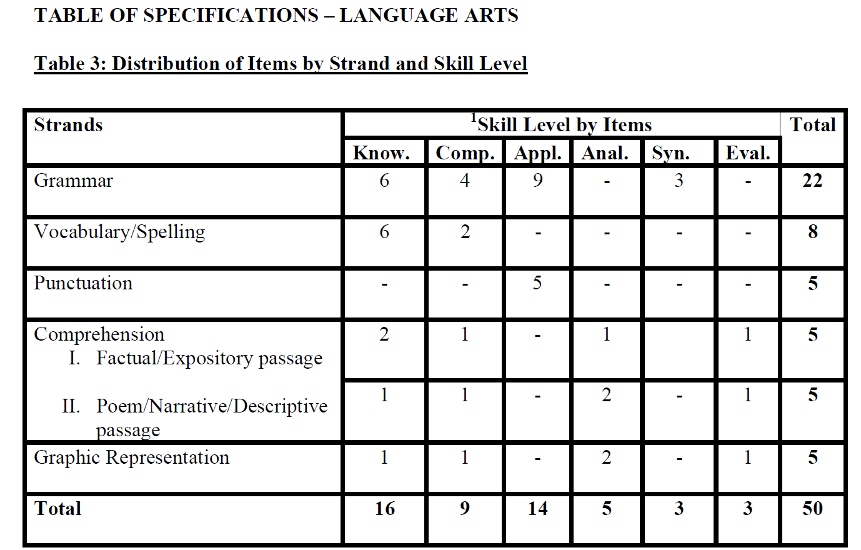

Slide 40
