Slide 1
TOBAGO WORKSHOP ON EDUCATIONAL ASSESSMENT Day 2, Session 1
©JEROME DE LISLE, REAIG, 2013

Slide 2
DAY 2: NATIONAL LEARNING ASSESSMENTS & PUBLIC EXAMINATIONS
PLENARY: ASSESSMENT OF LEARNING: LARGE SCALE ASSESSMENT
TUTORIAL: UNDERSTANDING AND USING NATIONAL TESTS IN AN EDUCATION SYSTEM WHAT TO DO WITH THE DATA
PLENARY: PUBLIC EXAMINATIONS IN THE CARIBBEAN-PERSISTENCE AMIDST CHANGING DESIGNS
TUTORIALS: DISCUSSING THE ROLE AND IMPACT OF THE SEA/CAC IDENTIFYING HOW TO WORK WITH MULTI-USE ASSESSMENTS BEST PRACTICE IN THE CAC
VOLUNTARY AFTER WORKSHOP SESSION: USING DATA FROM LARGE-SCALE ASSESSMENTS TO FOSTER SCHOOL IMPROVEMENT

Slide 3
Focusing on assessment systems
An assessment system is a group of policies, structures, practices, and tools for generating and using information on student learning and achievement.
Marguerite Clarke, World Bank, 2012
Effective assessment systems are those that provide information of sufficient quality and quantity to meet stakeholder information and decision-making needs in support of improved education quality and student learning outcomes.

Slide 4
Different Assessments, Different Purposes
CLASSROOM ASSESSMENT
CLASSROOM ASSESSMENT
To promote & measure
Student Learning
To promote Student Learning
NATIONAL ASSESSMENTS
NATIONAL ASSESSMENTS
To measure institutional & system quality
To measure institutional & System quality
PUBLIC EXAMINATIONS
PUBLIC EXAMINATIONS
To select & certify
To select & certify
INTERNATIONAL ASSESSMENTS
INTERNATIONAL ASSESSMENTS
To measure and compare system
quality across nations
To measure and compare system quality

Slide 5
Definitions
Public examinations are high-stakes assessments used for selection, certification, or qualification. (traditionally at 11+, 16+, & 18+).
Classroom assessment includes all the assessment and measurement strategies (formative & Summative (Assessment of, as and for learning) used by the teacher within the classroom.
National assessments of Educational Achievement (National Learning Assessments) are large scale assessments used for monitoring a nation al system or parts of that system.
International assessments are large scale assessments used for comparing performance across several nation systems or within a region.

Slide 6
Examples
Public Examinations- SEA, CAC, CSEC, CAPE
International Assessments- PISA, PIRLS
National Assessments- National Tests, NCSE
Classroom Assessment- CAP

Slide 7
The process of assessing
Monitoring
Accountability
Benchmarking
Evidence
Judgment
Decision
Inference

Slide 8
A Matter for Reflection
There are multiple sources of evidence in the system and teachers must be judicious in selecting the evidence they used for data-informed instruction.
The best type of evidence for everyday and placement decisions in the school is classroom assessment data, which provides multiple samples of performance.
However, this quality of evidence is also dependent upon the teachers’ assessment literacy and skill.

Slide 9
Using data from large scale assessment
Use should be related to the original purpose of the assessment.
Large scale data is not useful for individual decisions because of the nature of the sample (number of items and number of administrations).
Large scale data is useful however for making several institutional and group decisions. For example, what were some weaknesses in the Standard Three Language Arts National Tests? How can the school improve its teaching-learning-assessment system to enhance performance in the SEA/CAC?

Slide 10
National Assessments
Trinidad does not yet have a clearly defined national assessment or monitoring system although the current policy allows National Tests but not the NCSE to operate in this way.
The idea is to inform schools and policymakers about curriculum coverage and performance.
Survey data has only be collected by the DERE once

Slide 11
National Assessments – How it Started
The origins of this type of assessment is found in the declaration of WCEFA [World Conference on Education for All held in Jomtien, Thailand in March 1990] which specified the importance of measuring learning achievement.

Slide 12
National Assessments – How it got started
World Bank, UNESCO, UNICEF and UNDP with some 1500 people representing 155 governments, 33 intergovernmental bodies, and 125 non-governmental organizations (NGOs), institutes, and foundations.
The conference was organized in response to the widespread concern over the deterioration of education systems during the 1980s.

Slide 13


Slide 14
National Assessments

Slide 15
Why National Assessments?
National assessment is an important key in improving the quality of education because of the need to obtain information about the level of student achievement in the system.
Although there is now considerable interest in what students are actually learning, information about that learning is fairly rare, especially in the Caribbean.

Slide 16
Best practice for national assessments
National Assessments
work bests when the exam is low stakes and positioned at key points in the system.
Should use multiple assessment modes
Should use criterion or standards-referenced methods to determine achievement
Should not be used for other purposes such as diagnostic testing, certification, or school based assessment.

Slide 17
A rationale for national assessments
Information from national assessments is needed to
reach a judgment about the adequacy of achievements generated in the education system
use as baseline data against which to measure progress in an educational reform programme
document demographic differences.

Slide 18
Multiple Purposes for National Tests in T&T
National Test is administered at Standards 1-IV at the end of each academic year by the Division of Educational Research and Evaluation (DERE) in public and private primary schools in Trinidad and Tobago. The information from these tests is used for the following purposes:
to gather information as feedback for decision making at the district and national level.
to track students’ progress, across time, in the school.
to compare students’ performance by school, educational district and nationally.
to identify national norms.
to point to aspects of teaching and learning that may require further investigation.
to discriminate between essential and desirable levels of curriculum.
to determine students’ strengths and weaknesses at the school, district and national levels. (Ministry of Education, 1997, p. 11).

Slide 19
Two forms of reporting
Norm Referenced using standard scores (NCE) with a mean of 50.0
And standards referenced
System of three standards developed working with DCD and DERE

Slide 20
Performance Standards & Definitions
Exceeds the Standard (Level 4)
The student exceeds the overall standard of work required at this level. This is superior academic performance. The student consistently displays an in-depth understanding of the work with an exemplary display of the skills required in all areas.
Meets the Standard (Level 3)
The student meets the overall standard of work required at this level. This is satisfactory academic performance with a solid understanding and adequate display of the skills required.
Nearly Meets the Standard (Level 2)
The student nearly meets the overall standard of work required at this level. This is marginal academic performance and includes work that approaches, but falls short of meeting satisfactory performance. The performance indicates a partial understanding and a limited display of the skills required.
Well Below the Standard (Level 1)
The student performs well below the standard of work required at this level. This is inadequate academic performance indicating little understanding and minimal display of skills required. There is a major need for additional instructional opportunities, remedial assistance and/or increased student commitment to academics in order to achieve at Level 3.

Slide 21

Standards represent variations in students performances on test
WBS

Slide 22

ES

Slide 23
Theory of Action for Trinidad National Tests

Slide 24
How a School Performance System Operates (Verhaeghe et al., 2009)

Slide 25
The Trinidad & Tobago National Test System
A variety of data types are provided to empower schools to better served its clients.
Includes single index indicators, graphical displays of distributions and graphs
Can be further enhanced by attaching to demographic data and continuous assessments.

Slide 26
Interpreting National Test Data
Each data type requires understanding
A single number accountability index called the API designed to locate the school based on the proportions of students performing in the different levels.
A simple value-added measure based on the API scores over several years.
The proportion of students at each level for all listed subjects.
The average performance of the cohort in the school on the subjects and subjects strands reported by Norm Curve Equivalents (NCE)

Slide 27
The Accountability Index
Range API Scores | LABEL | DESCRIPTION
401-560 | EXCELLING | Extremely high proportions of students meeting or exceeding standards in both classes and areas of learning
241-400 | MOSTLY EFFECTIVE | Adequate to high proportions of students meeting or exceeding standards in both classes and areas of learning
81-240 | ACADEMIC WATCH | Inadequate numbers of students meeting or exceeding standards in one or more classes or areas of learning. Requires immediate attention to specific challenges faced by school.
< 80 | ACADEMIC EMERGENCY | Inadequate numbers of students meeting or exceeding in both classes and areas of learning. Requires urgent and immediate intervention

Slide 28
API Calculation
Class | Well Below | Nearly Meets | Meets | Exceeds | Sub Total | API
Math Std 1 | 20(.2) | 26(.6) | 40(1) | 14(1.4) | 79.2 | 302.6
Language Std 1 | 31(.2) | 26(.6) | 23(1) | 20(1.4) | 72.8
Math Std 3 | 27(.2) | 24(.6) | 33(1) | 16(1.4) | 70.2
Language Std 3 | 27(.2) | 24(.6) | 20(1) | 29(1.4) | 80.4

Slide 29
Value-Added Measure -Is my school progressing?

Slide 32
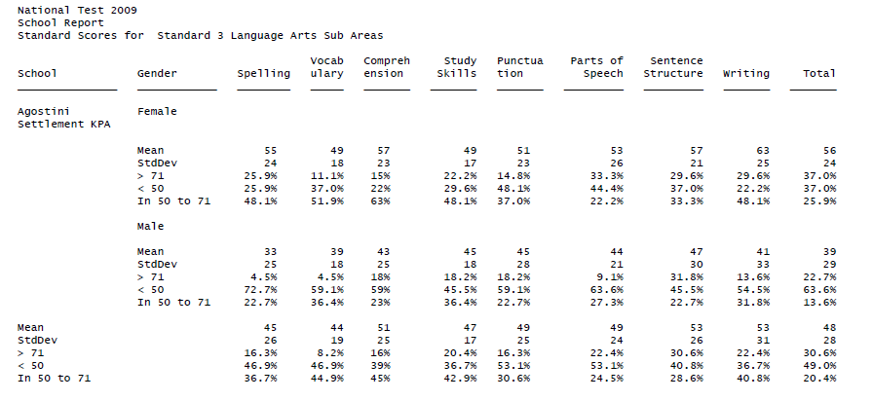

Slide 33
Making Better Use of National Test Data as a Teacher
Work in a school improvement team, department or professional learning community to examine the cohort data.
Discuss and construct inferences from the data
Explore implications of inferences
Research actions that might address the issues. Privilege evidence-base interventions.
Select interventions from different subsystems-home, school, community, child.

Slide 34
International Assessments
International comparative assessments have their origin in the late 1950s, somewhat earlier than national assessments.
They grew out of a consciousness of the lack of internationally valid standards of achievement with which individual countries could compare the performance of their students.

Slide 35
International Assessments-Administering Agencies
Most international assessments have been carried out under the auspices of the International Association for the Evaluation of Educational Achievement (IEA). This agency administers the TIMSS and PIRLS. In 1999, the OECD set up the Programme for International Student Assessment (PISA).

Slide 36
Trinidad in International Assessments
Trinidad is the only Caribbean country now enrolled in international assessments. The use of international assessment data was clearly explained in the Vision 2020 plan.
Trinidad participated in the 2009 PISA (15 years wherever you are in the Secondary school) and 2006 and 2011 PIRLS (Age 9-10, Standard 3)
Despite enrolment, limited use has been made of data in policymaking.
Nevertheless, significant improvement from 2006 to 2011

