Slide 1
TOBAGO WORKSHOP ON EDUCATIONAL ASSESSMENT
Day 2, Session 2
©JEROME DE LISLE, REAIG, 2013

Slide 2
DAY 2: NATIONAL LEARNING ASSESSMENTS & PUBLIC EXAMINATIONS
PLENARY: ASSESSMENT OF LEARNING: LARGE SCALE ASSESSMENT
TUTORIAL: UNDERSTANDING AND USING NATIONAL TESTS IN AN EDUCATION SYSTEM WHAT TO DO WITH THE DATA
PLENARY: PUBLIC EXAMINATIONS IN THE CARIBBEAN-PERSISTENCE AMIDST CHANGING DESIGNS
TUTORIALS: DISCUSSING THE ROLE AND IMPACT OF THE SEA/CAC IDENTIFYING HOW TO WORK WITH MULTI-USE ASSESSMENTS BEST PRACTICE IN THE CAC
VOLUNTARY AFTER WORKSHOP SESSION: USING DATA FROM LARGE-SCALE ASSESSMENTS TO FOSTER SCHOOL IMPROVEMENT

Slide 3
The process of assessing
Traditional Purposes
Selection
Certification
Placement
Evidence
Judgment
Decision
Inference
Emerging Purposes
Learning
Monitoring
Diagnosis

Slide 4


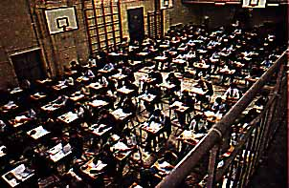

Public Examinations

Slide 5

PUBLIC EXAMINATIONS
Public examinations are high-stakes assessments used for selection, certification, or qualification (traditionally at 11+, 16+, & 18+).

Slide 6
PUBLIC EXAMINATIONS
Because these examinations are usually high stakes, effects are sometimes negative and unintended.
The term high stakes applies to the consequences and are experienced by test-takers, teachers and others
In the Caribbean and elsewhere, multi-use or multi-purpose designs are sometimes used in public examinations. Apart from the question of the validity of teachers’ judgment, theories of action must be formulated.

Slide 7
PUBLIC EXAMINATIONS
Public Examinations are conducted by, or on behalf of the State and are usually open to all those who meet clearly defined entry criteria.
These examinations are typically competitive, bringing benefits to those individuals who are successful.
Not all countries have public or high stakes exit examinations at the same point, however
  See http://www1.worldbank.org/education/exams/nature.asp

Slide 8
PUBLIC EXAMINATIONS-
A Brief History
The first written public examinations were introduced over 2000 thousand years ago, in China. They were designed to select the most able citizens for positions in the civil service and to reduce the effects of patronage.
News of the Chinese system was brought to Europe in the 16th century and the Jesuits incorporated like examinations into their schools.

Slide 9
PUBLIC EXAMINATIONS-
A Brief History
The Abitur (Germany/Finland) was introduced as a graduation examination for the classical middle school in 1788 and soon became a qualification examination for university.
The Baccalaureate was established in Napoleonic France in 1808 to admit students to the grandes écoles, government service, and the professions.
In Britain, London University held its first matriculation examination in 1838
In 1865, the New York Board of Regents conducted the first examinations in NY State schools.

Slide 10
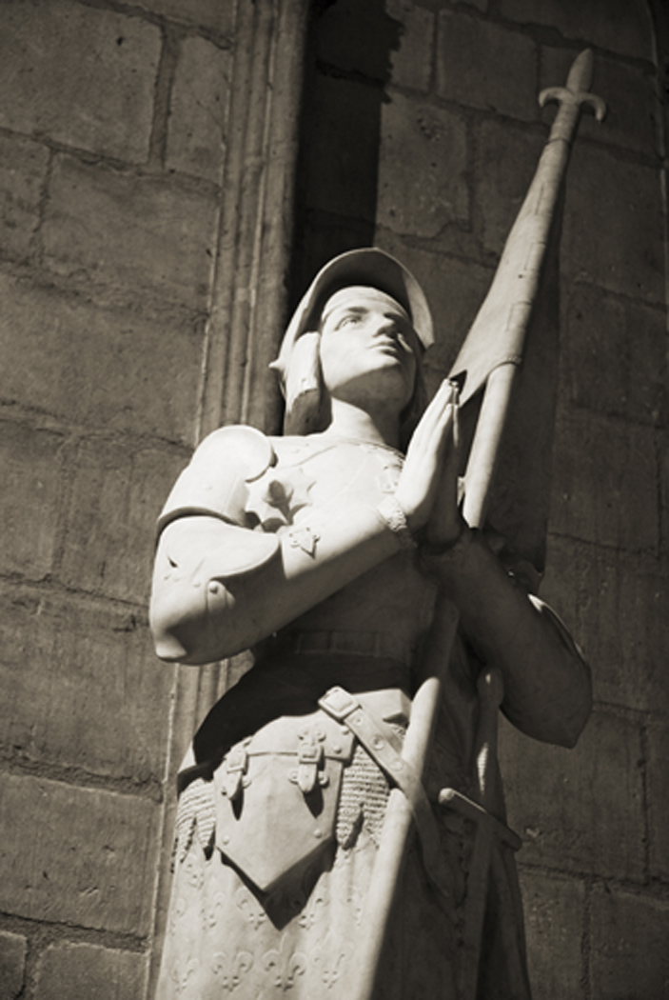
The History of Assessment in Trinidad

Slide 11
A BRIEF HISTORY OF ASSESSMENT IN TRINIDAD AND TOBAGO
Caribbean Societies have been traditionally very examination oriented, partly founded on the belief that success in schools or more specifically examinations provides the currency to achieve upward social mobility.
During the colonial era, much teaching was geared towards public examinations at 11+ and 16+
The selection examinations in Colonial systems were often included designed to weed out those considered the most likely to succeed and functioned as a gatekeepr.

Slide 12
A BRIEF HISTORY OF ASSESSMENT IN TRINIDAD AND TOBAGO
The focus on weeding out and separating remained amidst with little focus on assessment of learning (formative assessment).
Attempts by some scholars to imitate international emphasis on assessment for learning can becomes distorted because of strongly held traditions and beliefs of teachers.
Little attention has been paid to fundamental issues of test fairness and/or validity
There is also little support for test evaluation or measurement theory in constructing large-scale assessments

Slide 13
A BRIEF HISTORY OF ASSESSMENT IN TRINIDAD AND TOBAGO
Prior to the 1970s the assessment scene in the primary school was dominated by the Eleven-Plus
The emergence of CXC at 16+ in the 1970s led to a greater attention to using multiple modes of assessments, including performance assessments in SBAs.
There is now a growing trend towards assessment for the purposes of monitoring and accountability (national assessments).
In the Caribbean, however, assessment literacy, remains frightfully low

Slide 14
The CSEC & CAPE Designs
Employs both a multiple purpose and multimodal design in that
  Uses different types of assessment format
  Involves internal and external assessment
  Is allegedly criterion-referenced in grading

Slide 15
The SEA/CAC Designs
Extends measurement to multiple points
Emphasizes assessment for learning
Makes use of standardized continuous assessment for high stakes
The system is multiple purpose

Slide 16
Current CAC framework for Std 5
WRITING ASSESSMENTS (ELA)
WRITING PORTFOLIO
10%
Terms 1-3
PRACTICE ASSESSMENTS
(score not added)
Term 1- November
Term 2- January
FINAL ASSESSMENT
10%
Term 3- March
Score – 20% towards SEA

Slide 17
Tensions in SBA
SBA Activity has both summative and formative functions.
In formative, we are trying to help the student learn by providing feedback.
In summative, we are assigning them a grade or a mark as a judgment of performance
The teacher must reconcile his role as “assessor” and “judge”

Slide 18

Reconciling the Tensions

Slide 19
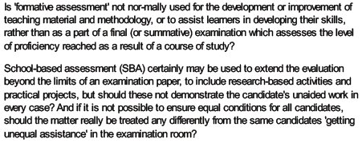
Reconciling the Tensions

Slide 20
Working within these systems can be a challenge
Develop systems that ensures that in the classroom the formative assessment aspect is mostly emphasized. Think protocols, which position formative assessment and feedback at key points.
Worked to reduce summative aspect and locate it at specific points.
Avoid teaching to the test by linking inquiry and activity to specific outcomes and standards contained in assessment frameworks.

Slide 21
Preparing test-takers for performance
Some students may require strategy and anxiety reduction for some components such as the multiple choice paper.
Use teaching strategies linked to expected outcomes-for example discussion for deep learning outcomes.
Review examination reports to highlight weaknesses.
Provide high quality practice by developing your own examination papers.

Slide 22
Eight Strategies
Build social capital through conversation
Provide practice tests.
Emphasize not giving up-invoke a success mind-set.
Give timed tests.
Teach students test-taking strategies.
Prepare students to deal with test anxiety.
Make test settings as pleasant as possible.
Plan a special activity after tests are over.

Slide 23
Align formative assessments to Public Examination Standards
Decide on the skill that must be developed or is demanded-Problem solving, writing skills, observation.
Develop Formative assessments for use ion classroom that promote and activate such skills
Many CSEC and new primary school syllabi already have activities that convert easily into formative assessments.

