Slide 1
TOBAGO WORKSHOP ON EDUCATIONAL ASSESSMENT
Day 3, Session 1
©JEROME DE LISLE, REAIG, 2013

Slide 2
DAY 3: ITEM WRITING
This is the item writing/task development part of our workshop
PLENARY: ASSESSMENT OF LEARNING IN THE CLASSROOM: THE FAMILY OF SELECTED RESPONSE ITEMS
TUTORIAL: CONSTRUCTING SELECTED RESPONSE ITEMS ITEM WRITING RULES
PLENARY: ASSESSMENT OF LEARNING IN THE CLASSROOM: THE FAMILY OF CONSTRUCTED RESPONSE
TUTORIALS: DEVELOPING CONSTRUCTED RESPONSE ITEMS ITEM WRITING RULES
VOLUNTARY AFTER WORKSHOP SESSION: PRACTICE ON CONSTRUCTING AND REVIEWING ITEMS

Slide 3
What are SR Items
SELECTED RESPONSE ITEM/TASK- An exercise for which examinees must choose a response from an enumerated set (e.g. multiple choice or matching) rather than create their own responses or products (as in performance assessment).

Slide 4
Choosing the right assessment strategy
The 1999 Standards for educational and psychological testing recommends the use of multi-modal assessments.
However, there are general principles that should guide our choice of methods in the classroom and in large-scale assessment

Slide 5
Choosing the right assessment strategy
Selected Response like MCQs allow computer scoring and therefore can be more efficient for large numbers of items and examinees. Because more items are used in a paper. More topics are assessed and therefore these items usually ensure higher content validity. However, authenticity and cognitive complexity are difficult to promote and the assessments may be low inference.
Constructed Response often facilitate cognitive complexity and assessment of critical writing skills. However, efficient scoring systems are required. Modern systems can be computer scored.

Slide 6
Designing & Developing Selected Response Assessments
Focus on a single topic & important objective
Select relevant stimulus material for context-dependent items
Formulate a clearly stated problem based on the material- Use question or incomplete statement
Identify the answer (keyed response)
Identify plausible alternatives (distractors)
Use checklist to remove cues

Slide 7
How to create distractors
A term used in the unit but referring to a different concept
An everyday term that is close but misleading in meaning
A common misconception or confusion that students have
A plausible word or phrase that is meaningless but derives from something in the stem

Slide 8
Item Writing Rules
Every item should reflect specific content and a specific mental behaviour as derived from a table of specifications
Base each item on important content to learn; avoid trivial content
Use novel material to test higher order learning. Paraphrase textbook language when used in a test item
Keep the content of each item independent from content of other items on the test
Avoid over specific and over general content when writing items
Avoid opinion-based items.
Avoid trick items
Keep vocabulary simple for the group of students tested

Slide 9
Item Writing Rules
Avoid complex MC formats (& the MTF)
Format the Item Vertically
Edit and proof the items
Use correct grammar, punctuation, capitalization, and spelling
Minimize the amount of reading in each item
Ensure that the directions in the stem are very clear
Include the central item in the stem instead of the choices
Avoid window dressing (excessive verbiage)
Word the stem positively, avoid the use of negatives such as NOT or EXCEPT. If negative words are used, use cautiously and always capitalize or put in boldface.

Slide 10
Item Writing Rules
Write as many effective choices (distractors) as possible.
Make sure that only of these choices is the right answer.
Vary the location of the right answer according to the number of choices.
Place the choices in logical or numerical order.
Keep choices independent; choices should not be overlapping.
Keep choices homogenous in content and grammatical structure.
Keep the length of the choices about equal.
“None of the above” should be used carefully.
Avoid “All of the above”.
Phrase choices positively; avoid negatives such as NOT.

Slide 11
More Writing Rules
Avoid giving clues to the right answer
    Specific determiners (Always, never, completely & absolutely).
    Clang associations (choices identical to or resembling words in the stem)
    Grammatical inconsistencies
    Conspicuous correct choice
    Pairs of triplets of options that provide a clue to the correct choice
    Blatantly absurd, ridiculous options
Make all distractors plausible.
Use typical errors of students to write distractors
Use humor only if it is compatible with the stakes involved and the learning environment

Slide 12
Designing & Developing Constructed Response Assessments
Create a stimulus
Attach prompts that elicit the cognitive behaviour you desire
Match the keyword to the expected student response
Include high order keywords to elicit critical thinking

Slide 13
Samples
Samples are from the US-
Standard 2 (8-9) and Form 2 (12-13)

Slide 14
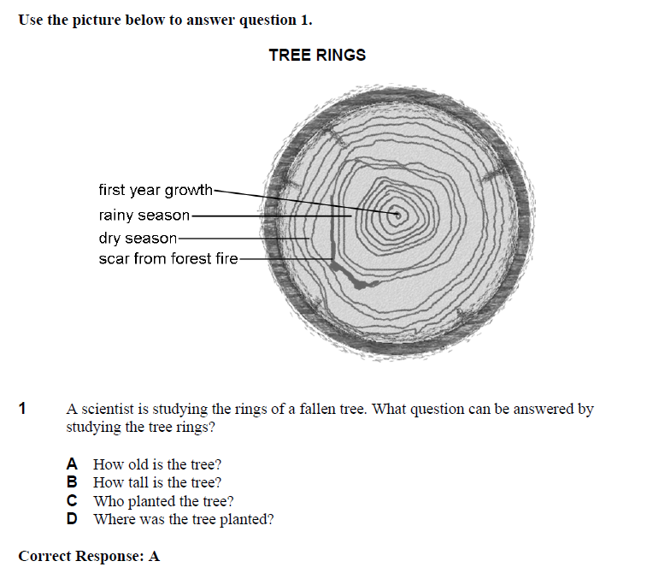

Slide 15
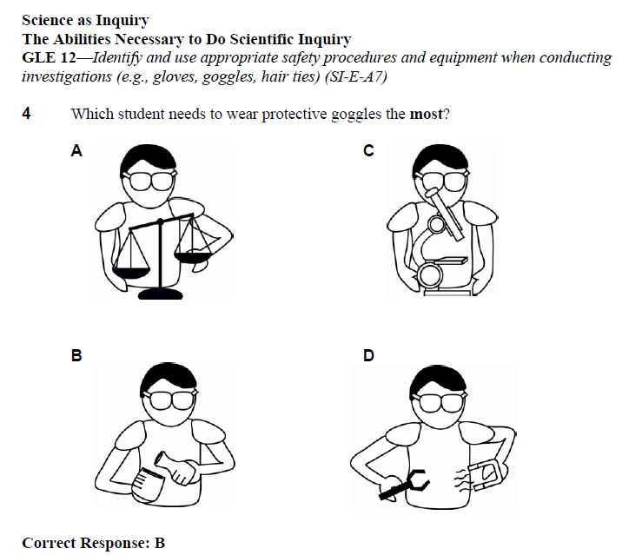

Slide 16
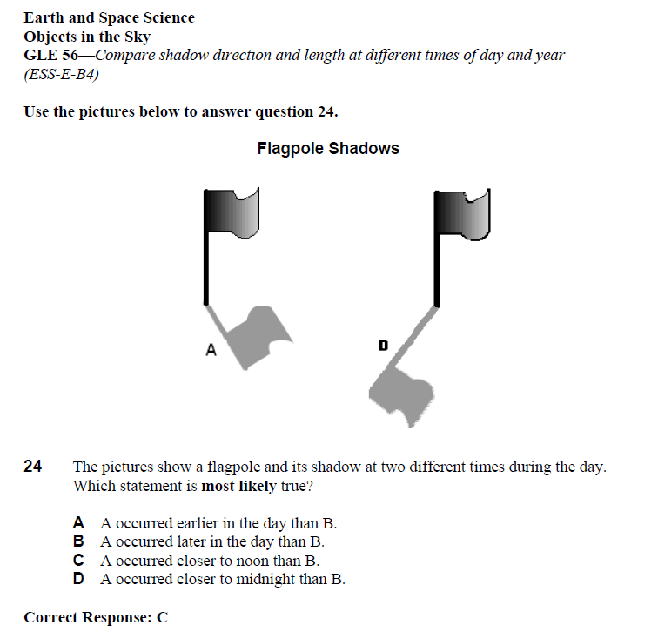

Slide 17
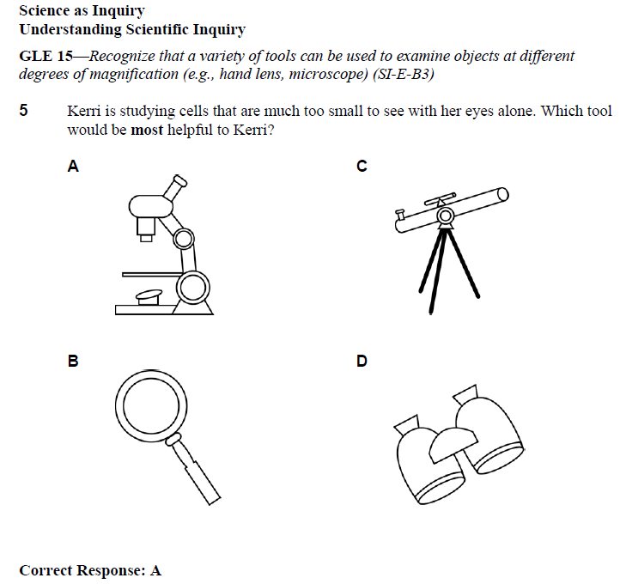

Slide 18
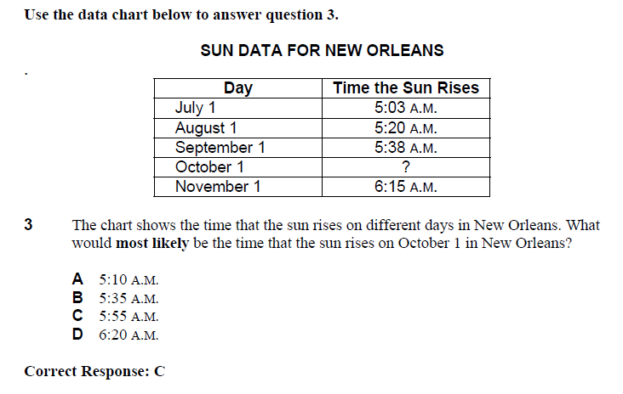

Slide 19
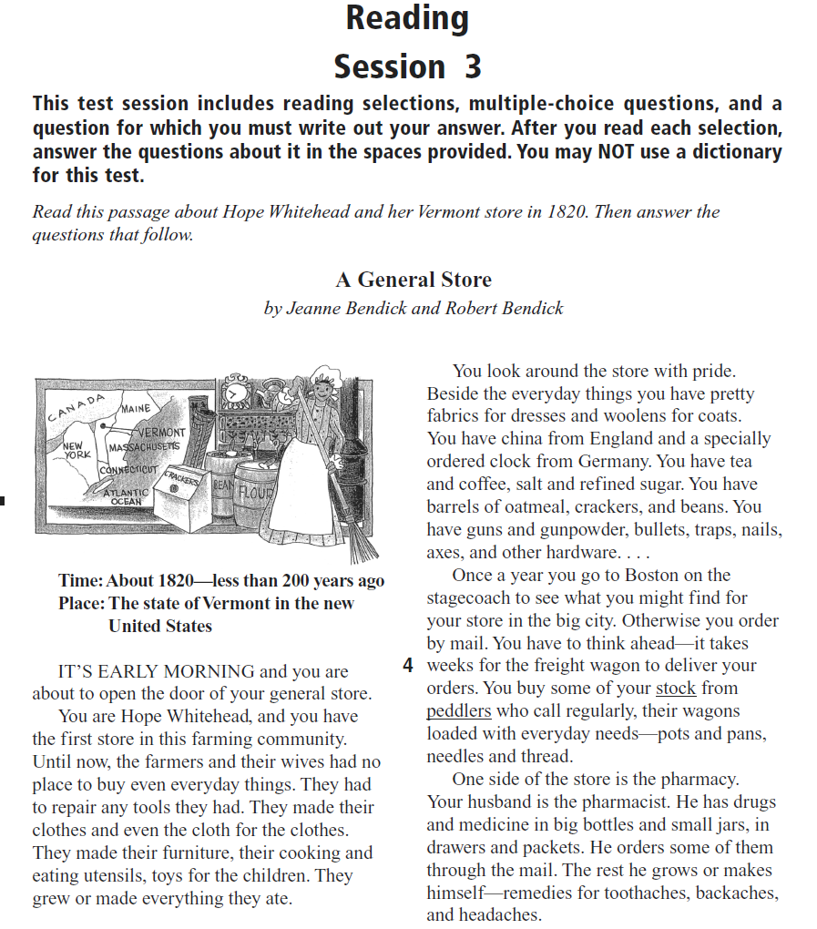

Slide 20
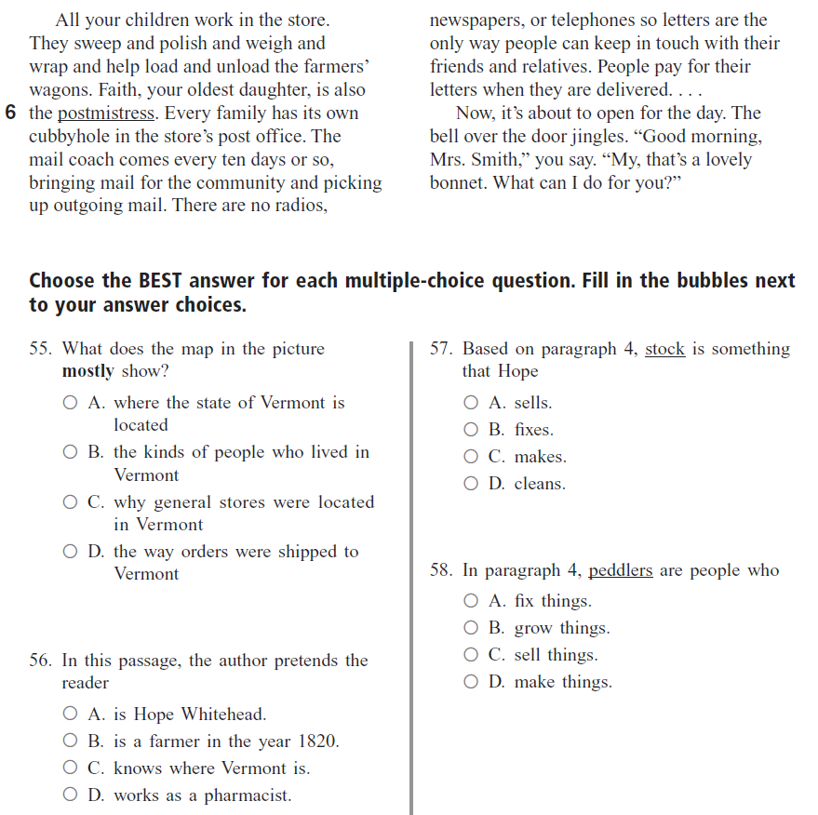

Slide 21
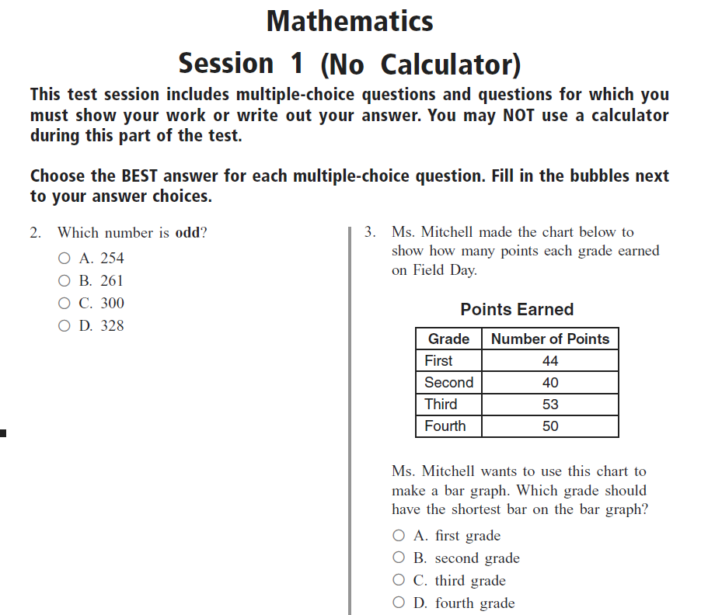

Slide 22
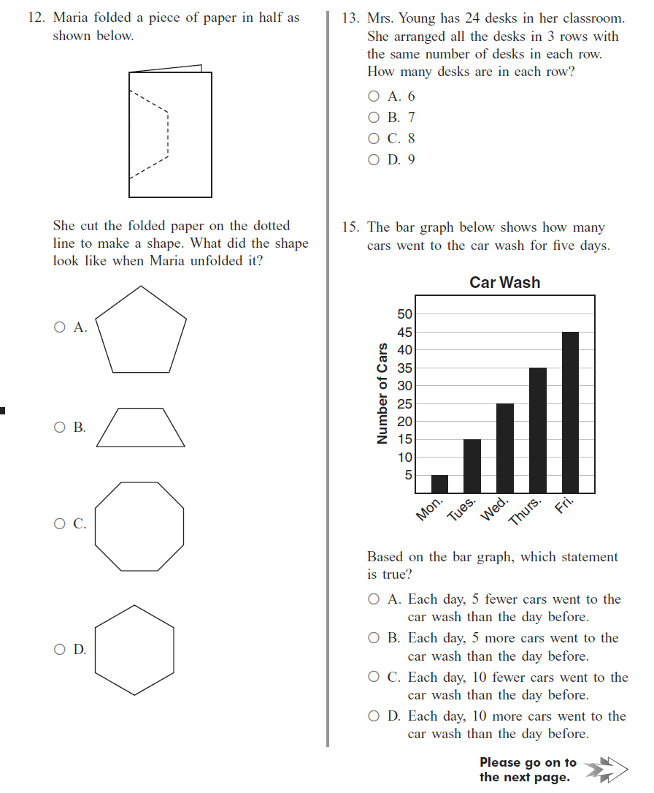

Slide 23
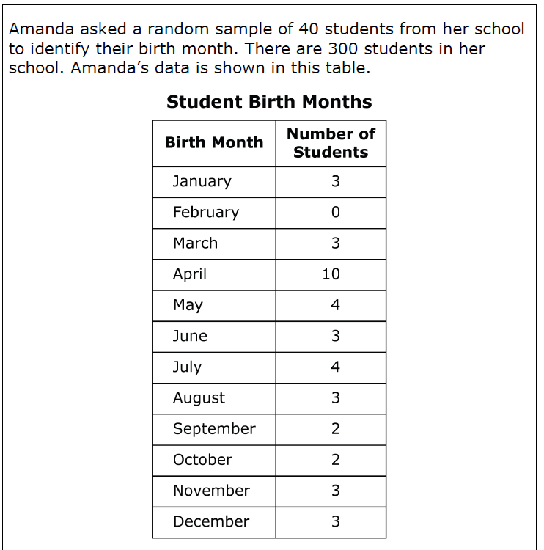

Slide 24
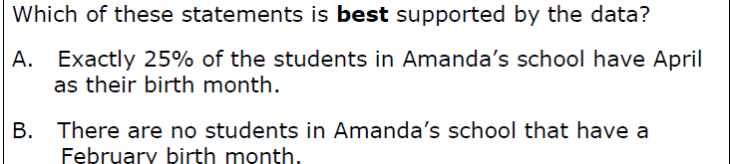
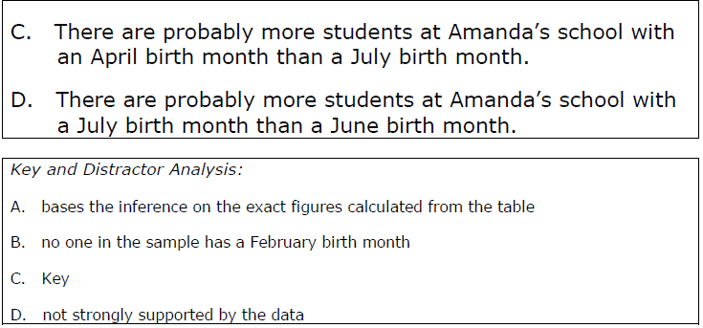

Slide 25
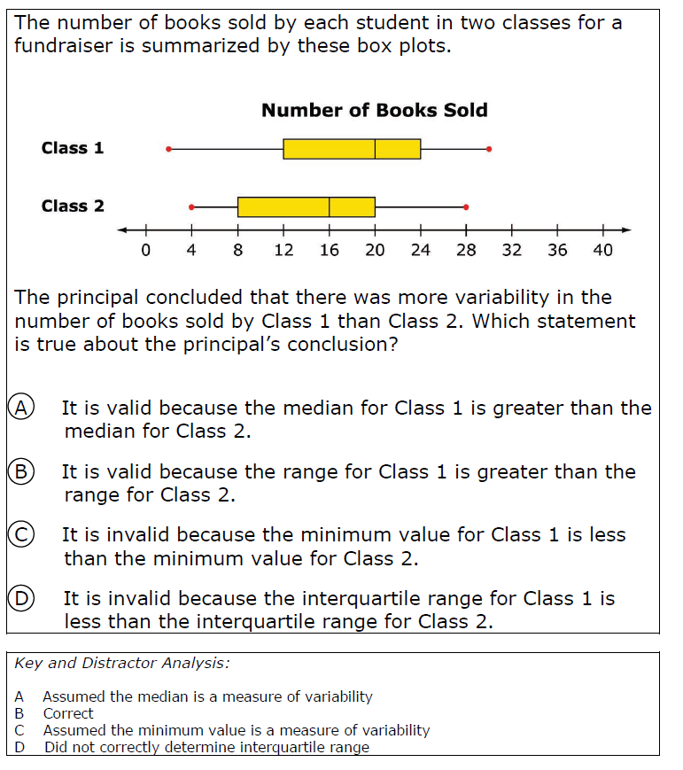

Slide 26
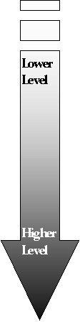
Different keywords in essay prompts?
Classification of Common Key Words Used in Prompts
Define
Name
State
List
Enumerate
Discuss
Apply
Organize
Interpret
Examine
Contrast
Differentiate
Appraise
Predict
Suggest
Develop

Slide 27

Restricted Constructed Response Item
Jennifer needs to put up a fence around her backyard. Her backyard is shown below. Step A Classify the shape of Jennifer's backyard. Step B Explain how you classified the shape of Jennifer's backyard. Use what you know about quadrilaterals in your explanation. Use words, numbers, and/or symbols.

Slide 28
Standard 2.0 Knowledge of Geometry
Topic A. Plane Geometric Figures
Indicator 2. Analyze geometric relationships
Objective a. Compare and classify quadrilaterals by length of sides and types of angles (Include the angle symbol <ABC) Assessment limit: Use squares, rectangles, rhombi, parallelograms, and trapezoids
Jennifer needs to put up a fence around her backyard. Her backyard is shown below. Step A Classify the shape of Jennifer's backyard. Step B Explain how you classified the shape of Jennifer's backyard. Use what you know about quadrilaterals in your explanation. Use words, numbers, and/or symbols. Step A is scored 0 (Incorrect) or 1 (Correct) and assesses 2.A.2.a. Step B is scored with a 3 point (0, 1, 2) rubric and assesses Processes of Mathematics.

Slide 29
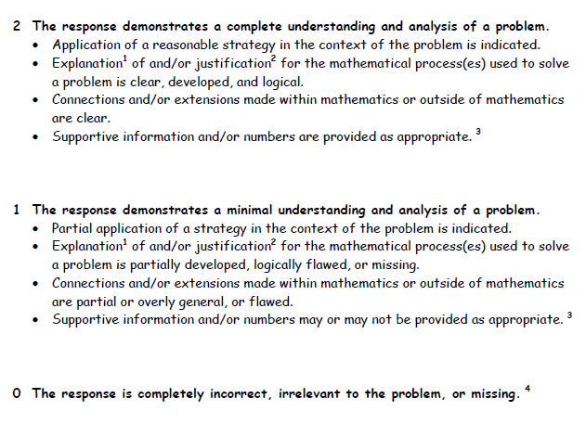

Slide 30
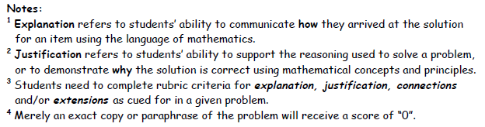

Slide 31
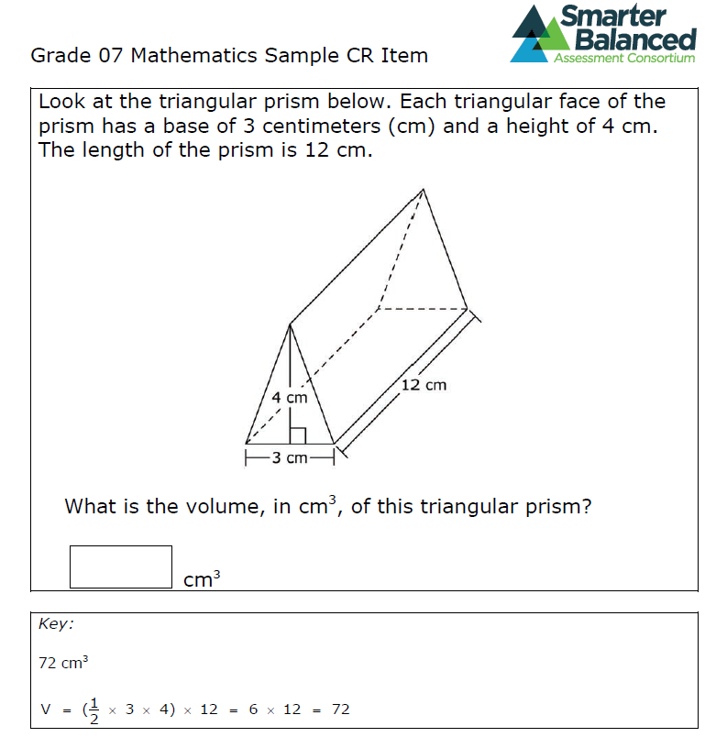

Slide 32
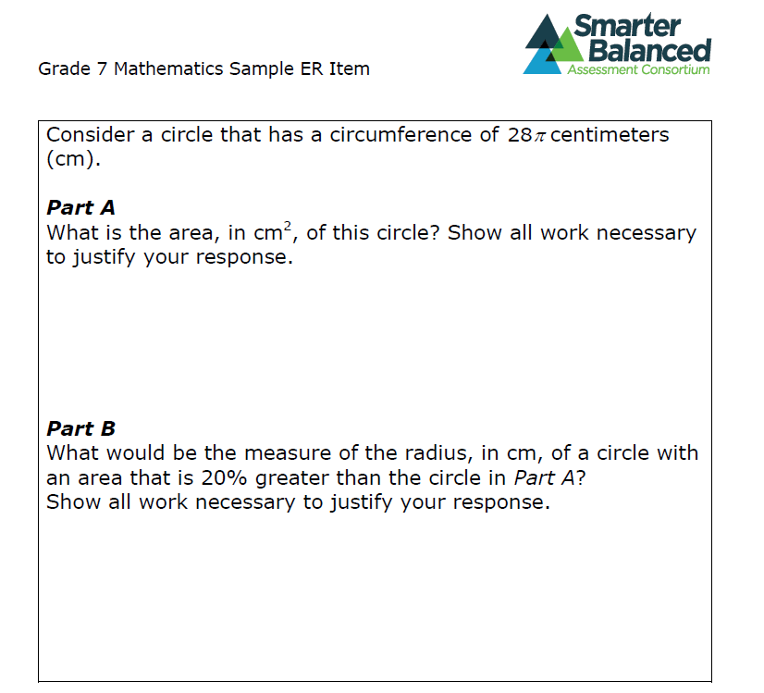

Slide 33
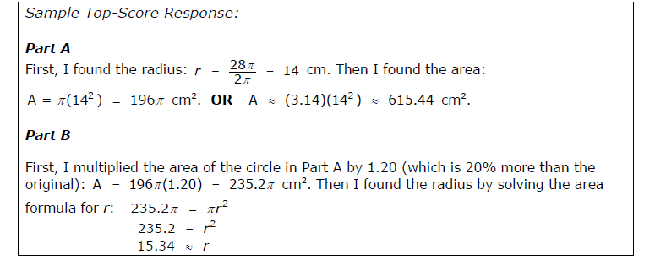

Slide 34
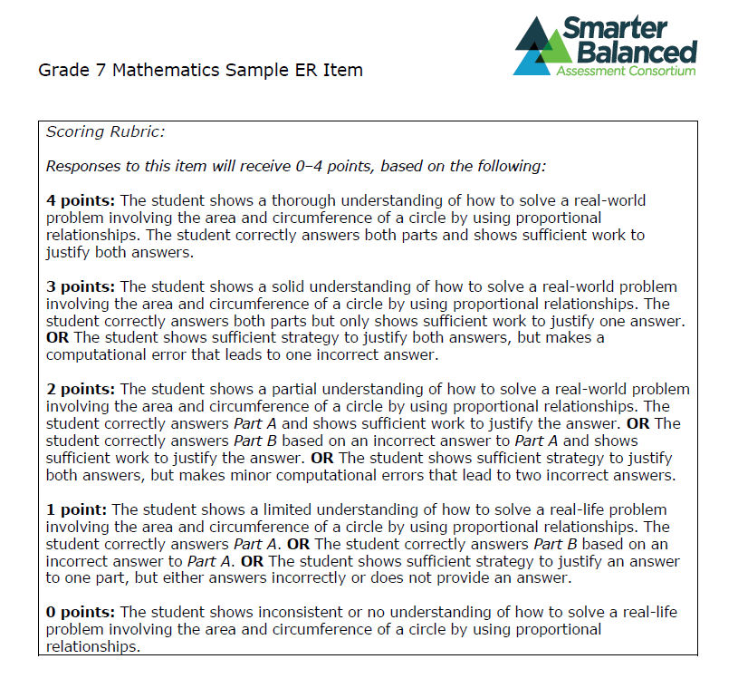

Slide 35
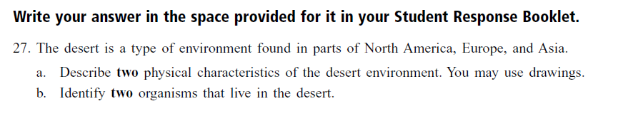
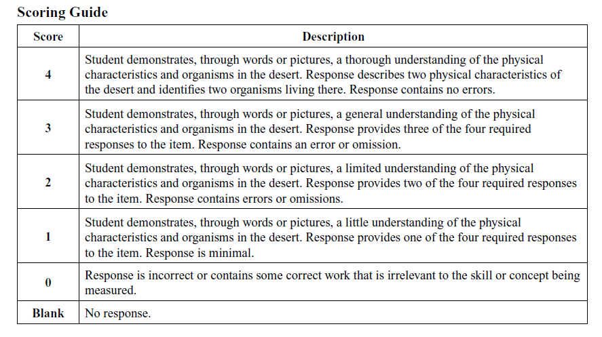

Slide 36
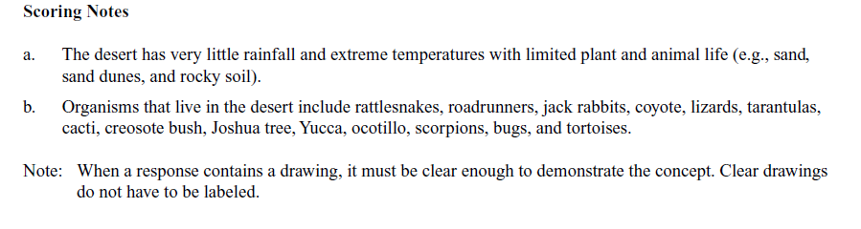
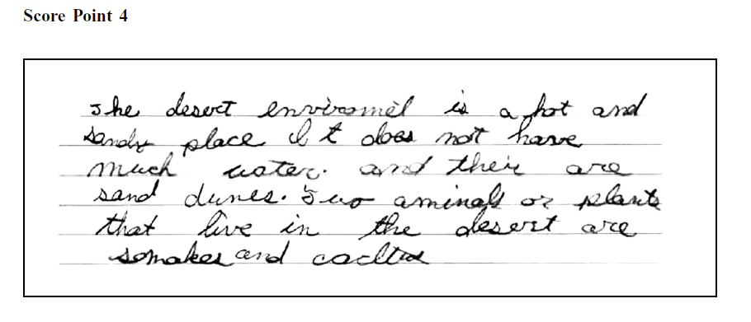

Slide 37
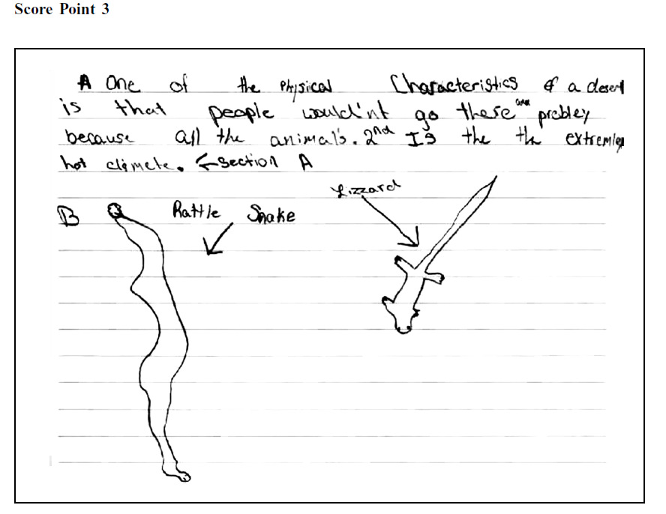

Slide 38
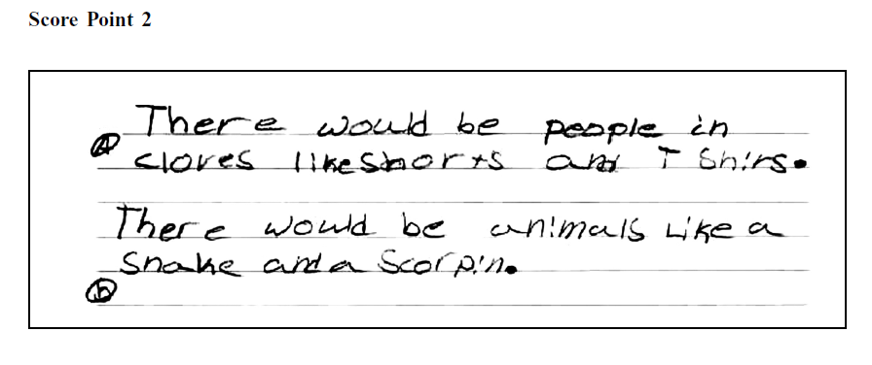
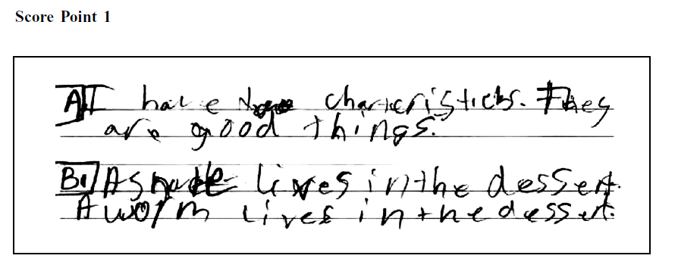

Slide 39
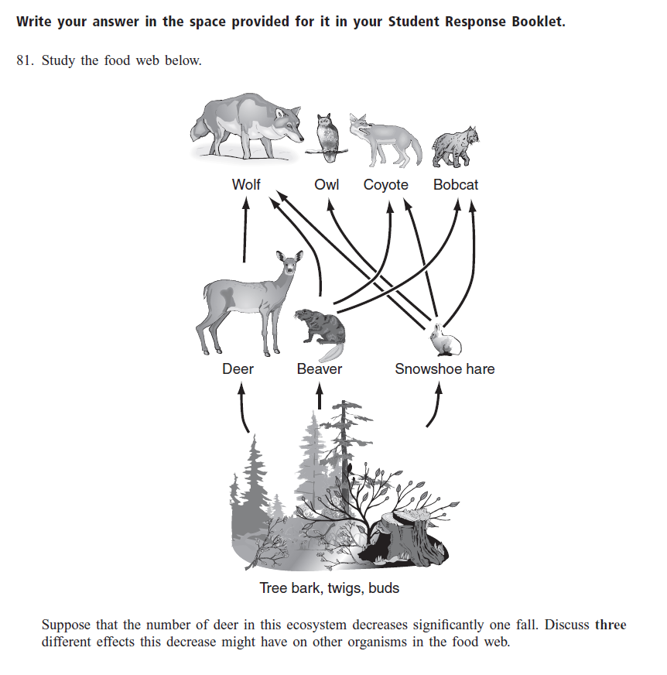

Slide 40
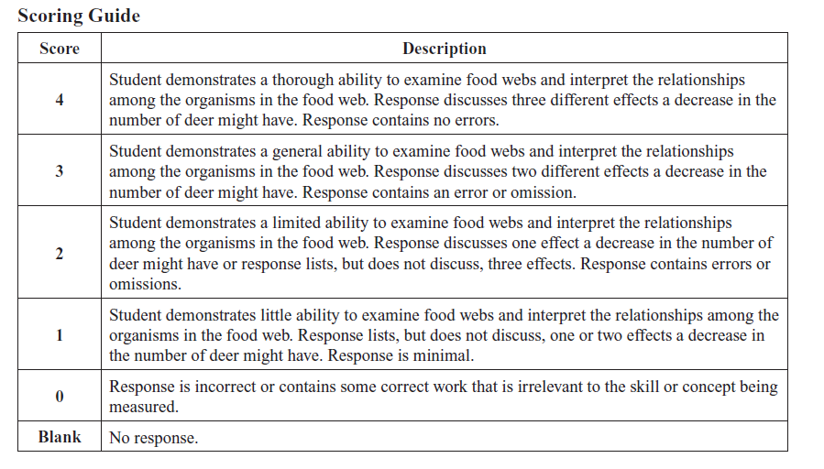

Slide 41
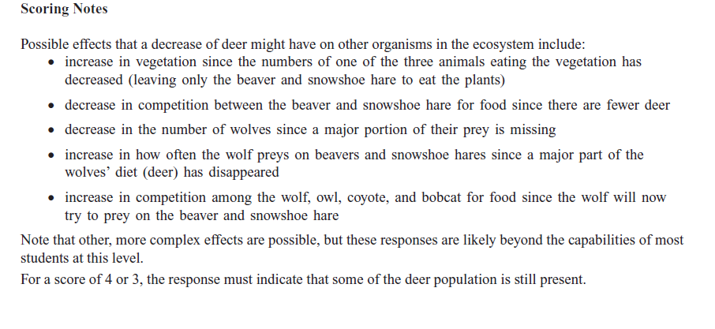

Slide 42
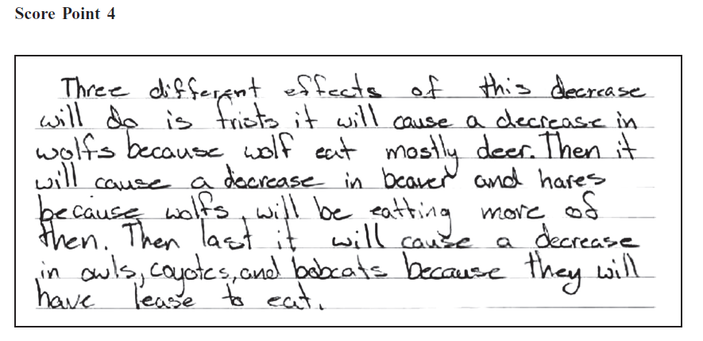
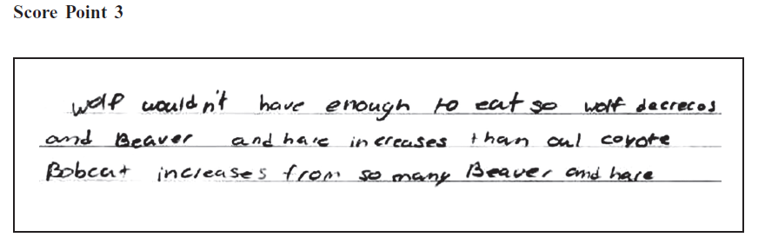

Slide 43
