Slide 1
TOBAGO WORKSHOP ON EDUCATIONAL ASSESSMENT Day 4, Sessions 1 & 2
©JEROME DE LISLE, REAIG, 2013

Slide 2
Day 4: Performance assessment tasks
PLENARY: ASSESSMENT OF LEARNING IN THE CLASSROOM: PAS
TUTORIAL: CONSTRUCTING HIGH QUALITY, AUTHENTIC PERFORMANCE ASSESSMENTS
PLENARY: ASSESSMENT OF LEARNING IN THE CLASSROOM: RUBRICS
TUTORIALS: DEVELOPING HIGH QUALITY RUBRICS
VOLUNTARY AFTER WORKSHOP SESSION: PRACTICE ON DEVELOPING RUBRICS

Slide 3
PLENARY ASSESSMENT OF LEARNING IN THE CLASSROOM: Performance Assessments

Slide 4
Better Understanding- Performance Assessments
Some performance tasks are designed to have students demonstrate their understanding by applying their knowledge to a particular situation.
For example, students might be given a current political map of Africa showing the names and locations of countries and a similar map from 1945 and be asked to identify and explain differences and similarities.
To be more authentic (more like what someone might be expected to do in the adult world), the task might be to prepare a newspaper article explaining the changes.

Slide 5
Better Understanding- Performance Assessments
Performance assessment tasks often have more than one acceptable solution (ill structured problem); they may also call for a student to create a response to a problem and then explain or defend it.
The process involves the use of higher-order thinking skills (e.g., cause and effect analysis, deductive or inductive reasoning, experimentation, and problem solving).
Performance tasks may be used primarily for assessment at the end of a period of instruction, but are frequently used for learning as well as assessment.
Source - http://www.ascd.org/portal/site/ascd/menuitem.4427471c9d076deddeb3ffdb62108a0c/

Slide 6
Definitions
A performance assessment is a evaluative task in which the student's active generation of a response is observable either directly or indirectly via a permanent product.
The task might be authentic in the sense that the nature and context in which the assessment occurs is relevant and represents "real world" problems or issues.

Slide 7
Illustrative Performance Assessment task

Slide 8
Designing & Developing Performance Assessments
Decide on the skills and competencies you want to assess (or develop)
Identify or Choose assessment tasks that are authentic, real-life, practical, and/or holistic
Develop instructions for the tasks
Decide on process or product focus
Decide on the amount of structuring necessary and include scaffolding if required
Develop a useful rubric

Slide 9
Help on choosing tasks
Does the task truly match the outcome(s) you're trying to measure?
Does the task require the students to use critical thinking skills?
Is the task a worthwhile use of instructional time?
Does the assessment use engaging tasks from the "real world?"
Can the task be used to measure several outcomes at once?
Are the tasks fair and free from bias?
Will the task be credible?
Is the task feasible?
Is the task clearly defined?
--Adapted from Herman, Aschbacher and Winters (1992

Slide 10
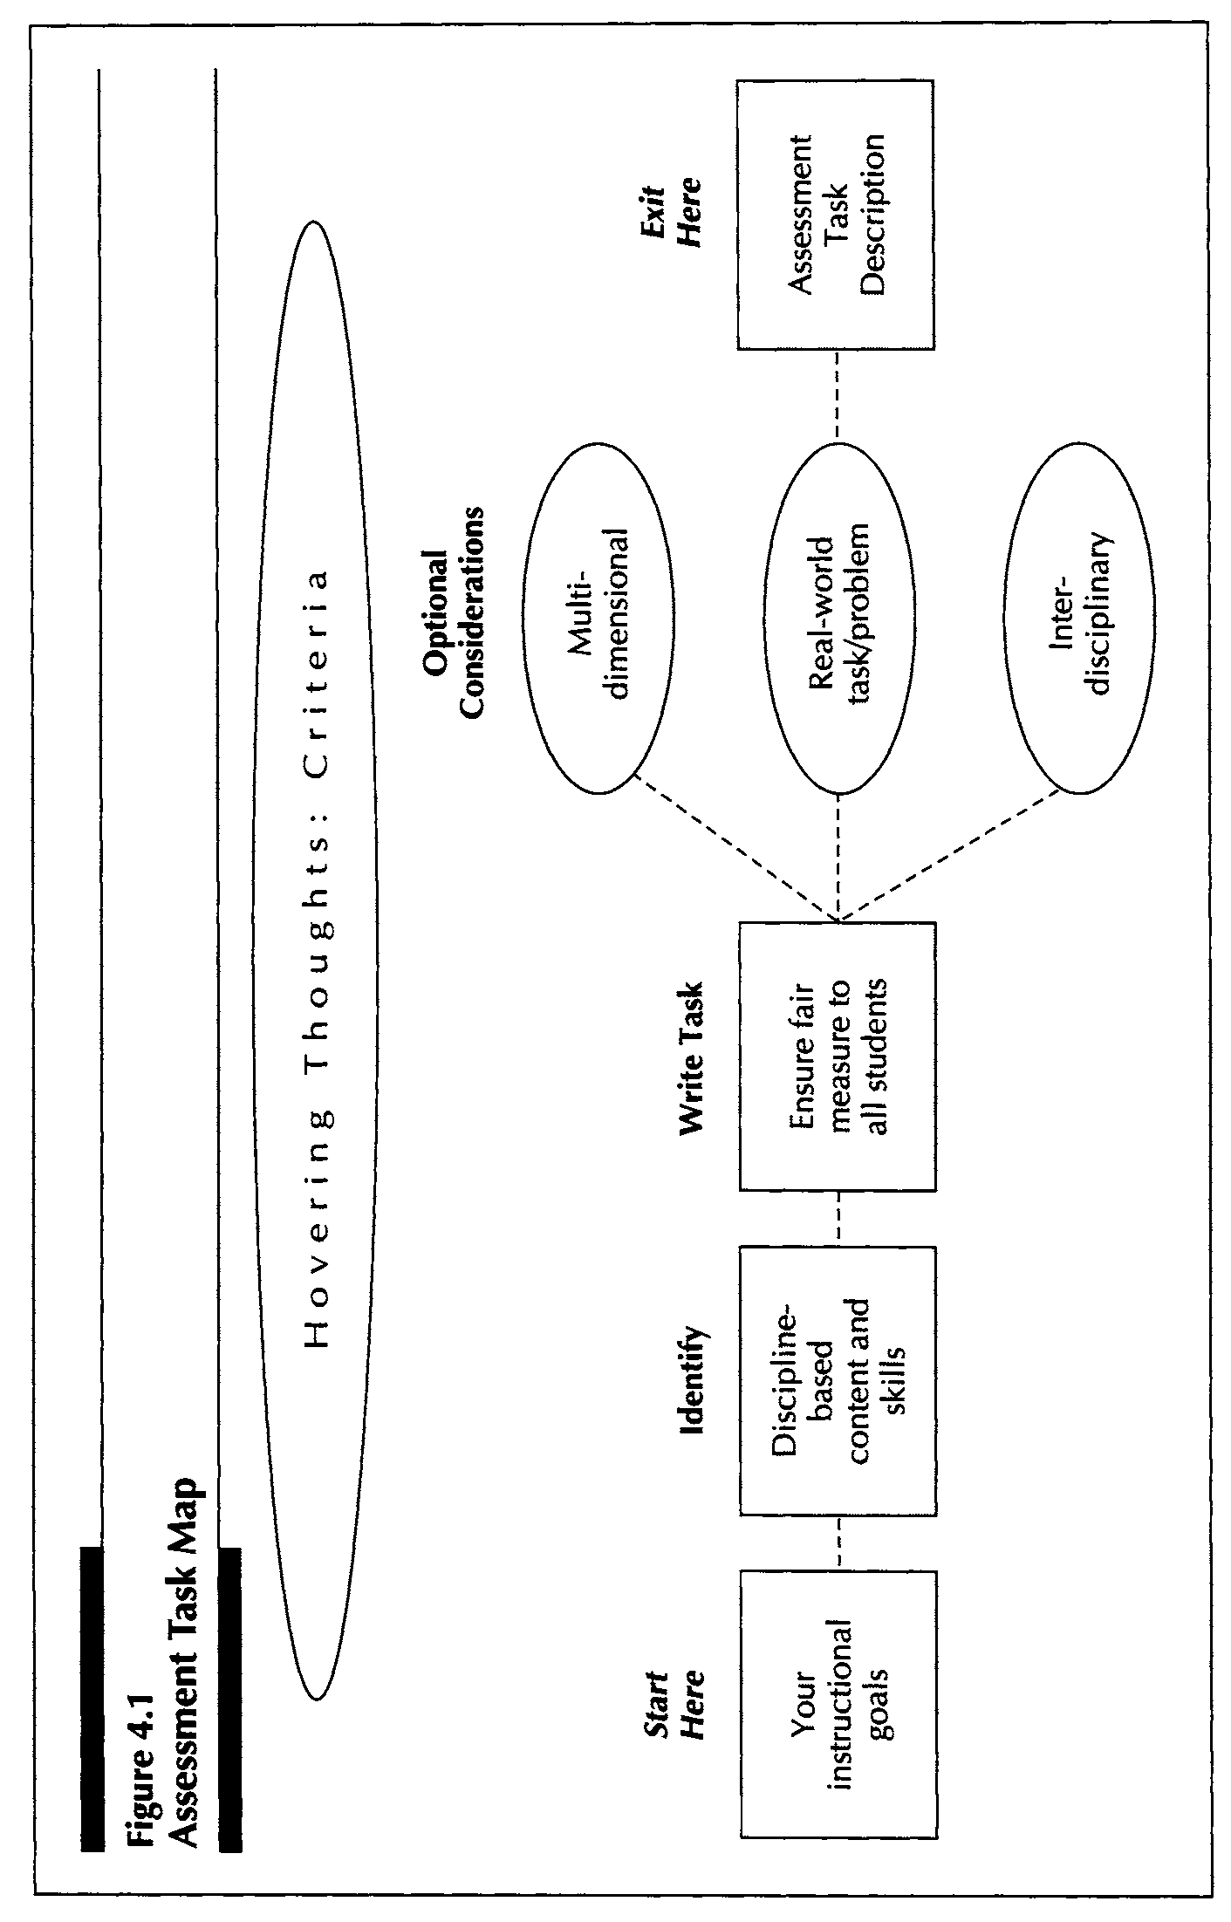

Slide 11
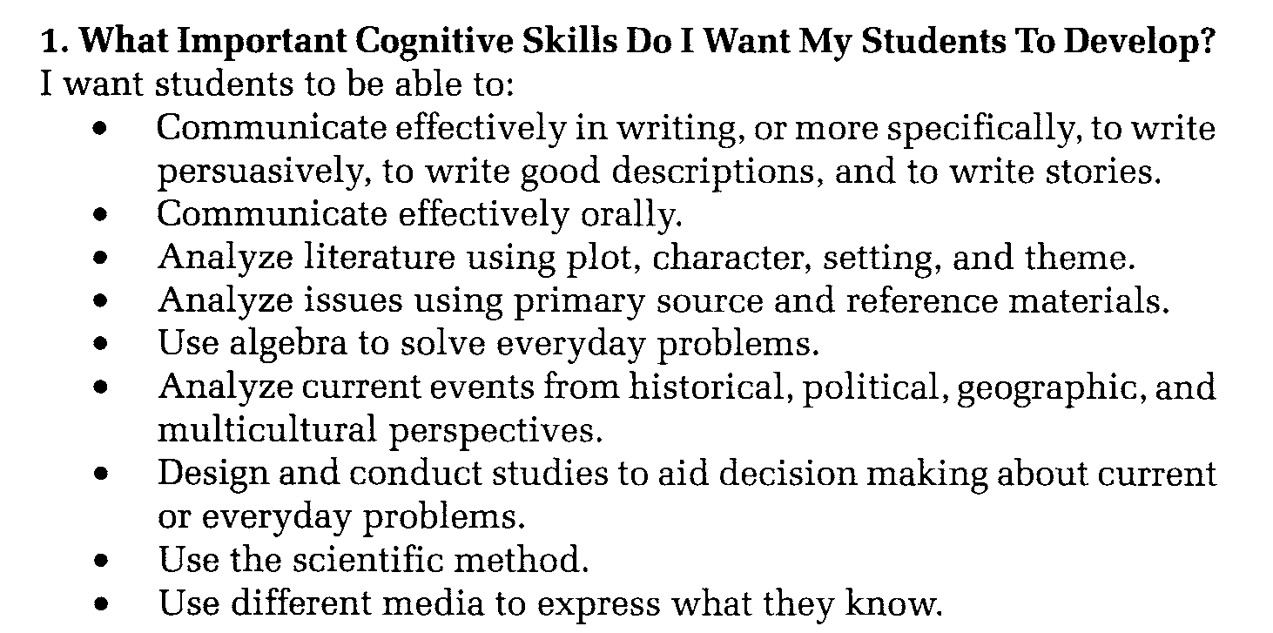

Slide 12
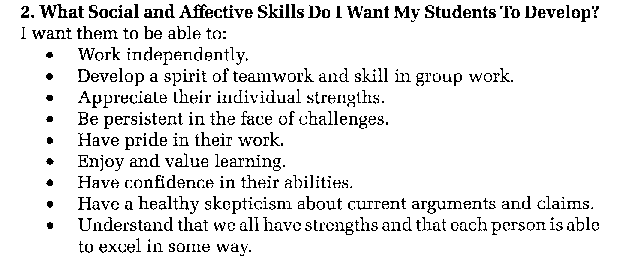

Slide 13
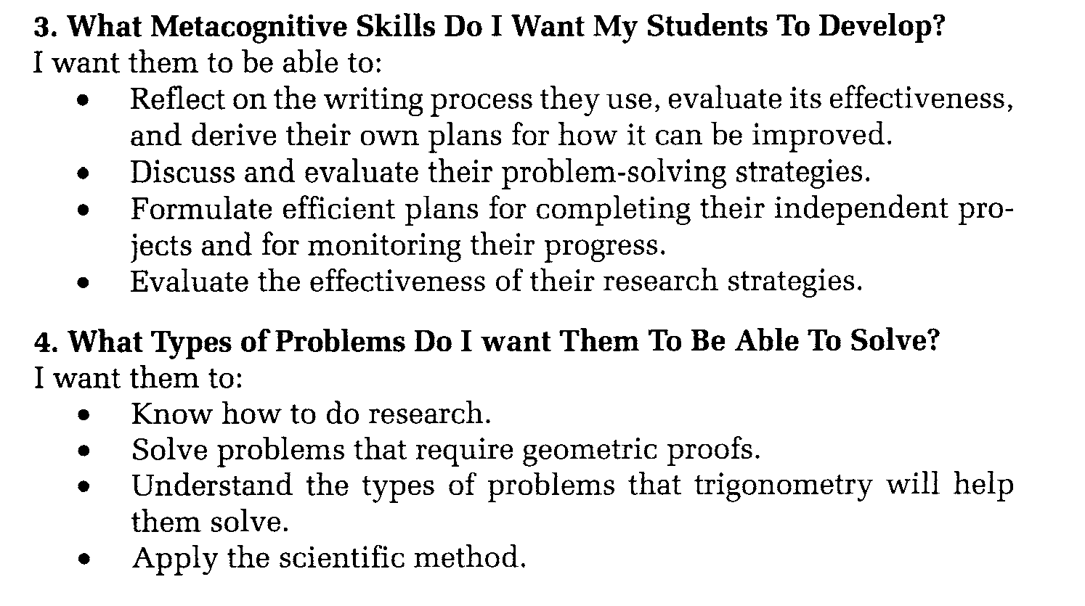
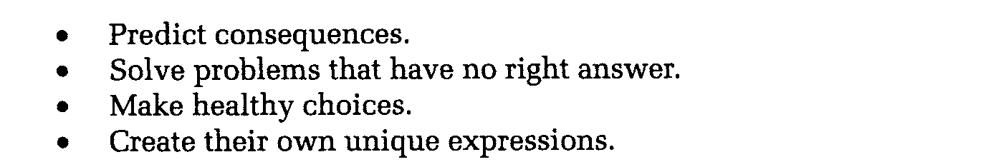

Slide 14
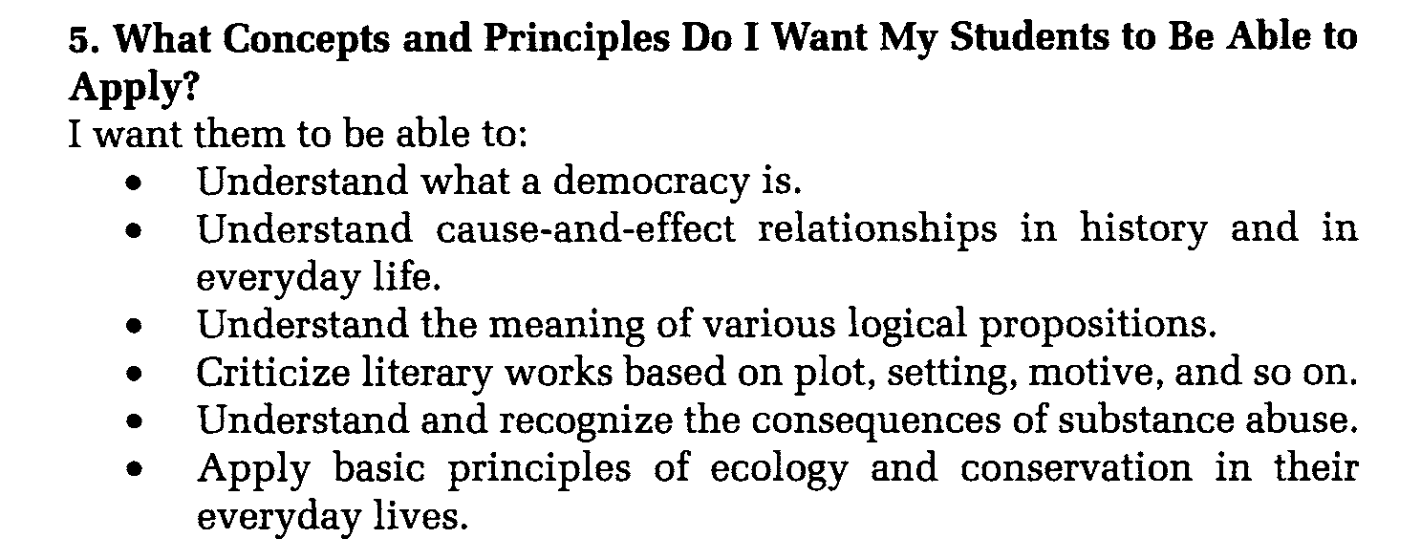

Slide 15
What a performance assessment looks like
Competencies/skills to assess
Authentic innovative performance tasks that elicit the behaviour & skills you require
An analysis of what the student will do
Instructions for students including scaffolding if required
Criteria for scoring & a rubric

Slide 16
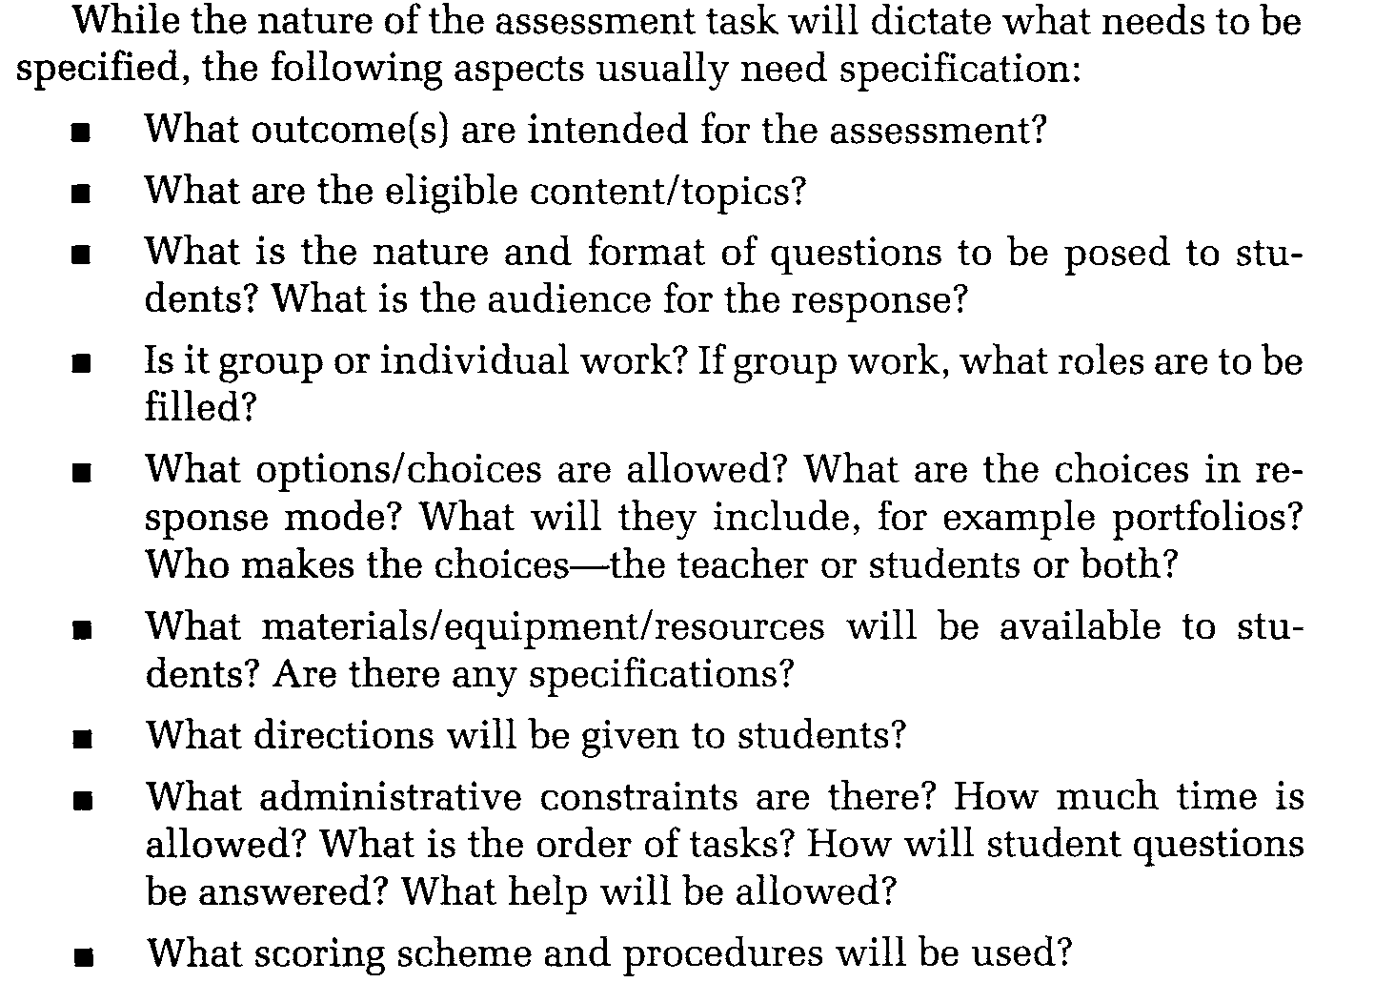
Describing your task

Slide 17
Designing a Performance Assessment
You should choose between structuring the task prompt, providing scaffolding, and ensuring authenticity in the design of the task.
Structuring the prompt means organizing to make it easier to understand. For example, you may arrange steps sequentially.
Scaffolding means providing additional information to support performing the task.
Authenticity means choosing aspects of design that facilitates the real-life nature of the task.

Slide 18
Task Design Challenges
Cognitive Challenge
Authenticity
Scaffolding
Structuring

Slide 19
Cognitive Challenge
The task should be holistic and complex enough to present a cognitive challenge for students. That means it makes demands on the skills they have and may develop during the process.
Performance assessments should be linked to learning theory-students should make meaning and their thinking is multidimensional and never linear

Slide 20
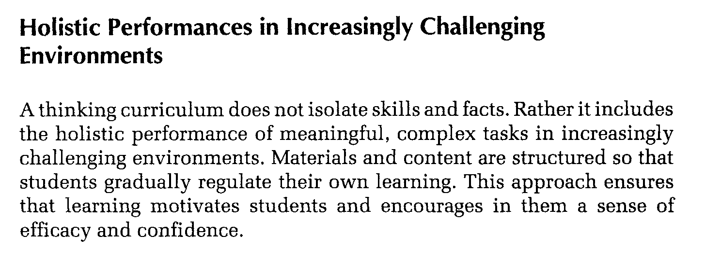

Slide 21
Authenticity
An authentic task presents a a real‐life situation that students can be confronted with in their future lives or professional lives.
This means that there is similarity between the cognitive demands ‐ the thinking required – of the assessment and the cognitive demands in the future life event or task.
There is also similarity in actions bearing in mind that real‐life situations demand the ability to integrate and coordinate knowledge, skills, and attitudes, and the capacity to apply them in new situations

Slide 22
Authenticity on a continuum

Slide 23
Scaffolding explained
Task 1 (Without Scaffolding)
Write an essay telling how life twenty years from now may be like the present and how it might be different. You may want to conclude with an evaluation: Will the future be better or worse than the present?
Task 1 (With Scaffolding)
When you studied history, you studied the past and compared it to the present. Now, consider how life twenty years from now may be like the present and how it might be different. Some areas you might write about in your comparison are: family life, transportation, education, food, housing, and government. You may want to conclude with an evaluation:
Will the future be better or worse than the present?
Write your composition using the following guidelines:
State the topic of your essay in the first sentence.
Remember to write about how you believe the future may be like the present and how it might be different.
Give specific examples and details. Fully explain how and why in the future each area would be like or different from the present.
Checkpoints to remember:
Take time to plan your essay on scratch paper.
Organize you ideas carefully. Remember what you know about writing complete paragraphs.
Check that you have used whole sentences, correct punctuation and correct spelling.

Slide 24
Balancing Challenge and Scaffolding
A performance assessment to be useful in formative assessment should be cognitively challenging. This means that the task should not be simplified to the point that it is no longer authentic.
Scaffolding is useful to the point that it does not reduce the cognitive challenge. Scaffolding should lead to future learning.
Some scaffolding might be provided through informal formative assessment practice.

Slide 25
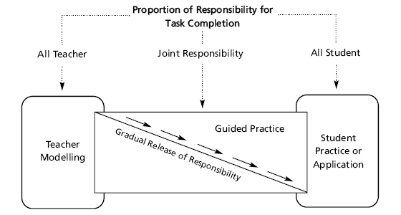
Scaffolding: shifting responsibility in the learning-teaching cycle

Slide 26
Brainstorming authentic tasks
Create a budget.
Create a spreadsheet.
Write a computer program.
Convert one type of graph or chart into another (e.g., pie chart into bar chart).
Draw the same graph to different scales.
Critique a chart, table or graph and explain how it might be made clearer or more useful.
Conduct a poll on consumer preferences, display results graphically, state conclusions.
Compare the accuracy over time of two different weather (or other) forecasts.
Conduct an opinion poll, create a chart or table of the results and explain your conclusions.

Slide 27
Brainstorming authentic tasks
Analyze how the author of an editorial uses persuasion.
Keep a journal.
Analyze how the author of a letter to the editor uses persuasion.
Analyze how a speaker uses persuasion.
Analyze a story.
Write a poem.
Solve an open-ended math problem, preferably one with multiple solutions or multiple paths to the correct solution.
Determine which store has the best prices.
Use mathematical manipulatives to illustrate a concept.
Prove a theorem or corollary that has not been done in class or the text.
Draw a floor plan.
Measure something.
Build a model.
Use a bus or train timetable to determine a schedule.
Estimate amount of food needed to feed a large group.

Slide 28

Balancing challenge with support: Scaffolding
Too much challenge & not enough support
Too little challenge & too much support
Scaffolding strategies include:
Modeling
Feeding back
Instructing
Questioning
Task structuring
Cognitive structuring
Tharp & Gallimore, 1988
Lantolf & Thorne, 2006

Slide 29
Four key features of successful scaffolding (Daniels, 2001)
Activity is currently beyond learner’s capacity to complete alone
Assistance provided is contingent on learner’s need
Mode of assistance potentially varies
Assistance is gradually withdrawn

Slide 30
Scaffolding and ‘feeding forward’
The goal of scaffolding is NOT short-term task completion
Scaffolding must ‘feed forward’ into long-term learning
Successful task completion must be used to motivate students to keep pushing themselves to the next level of challenge

Slide 31
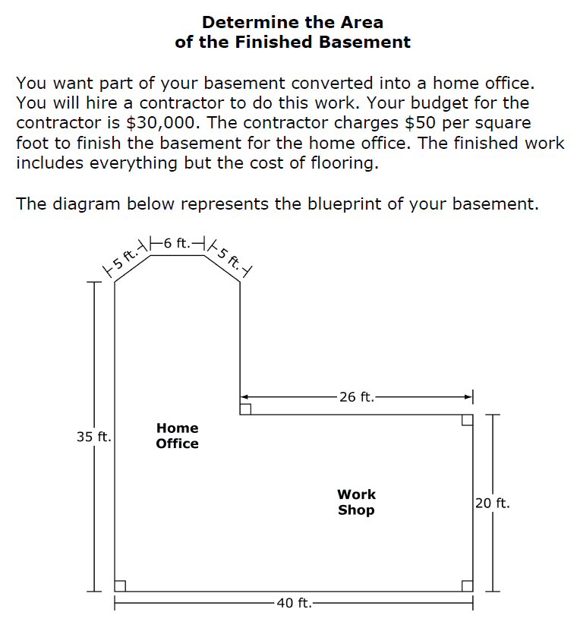

Slide 32
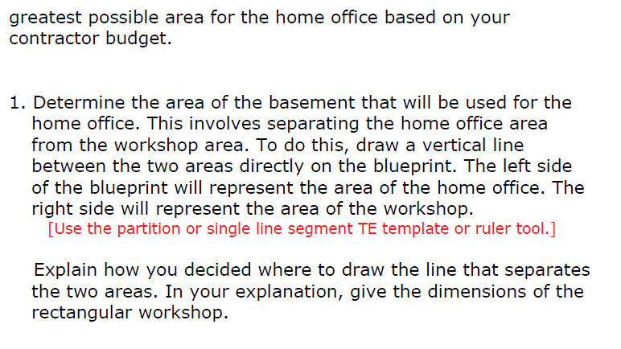

Slide 33
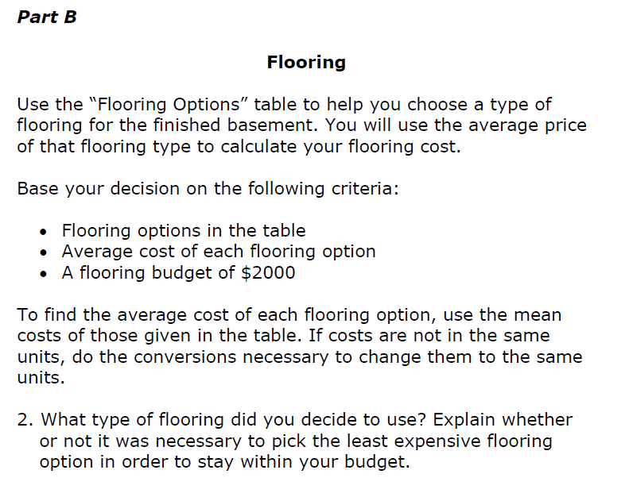

Slide 34
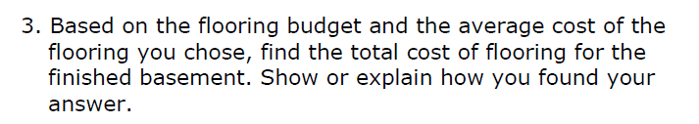

Slide 35
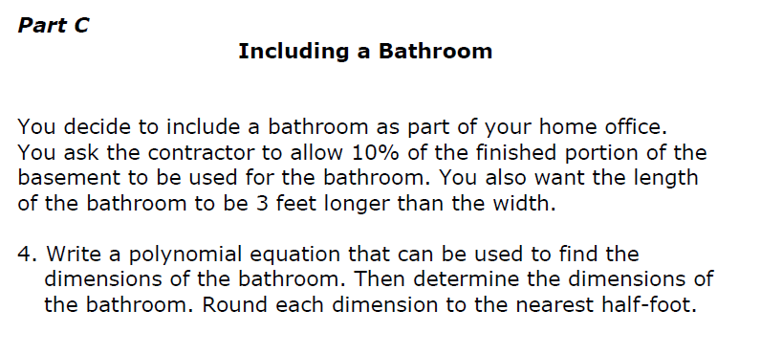

Slide 36
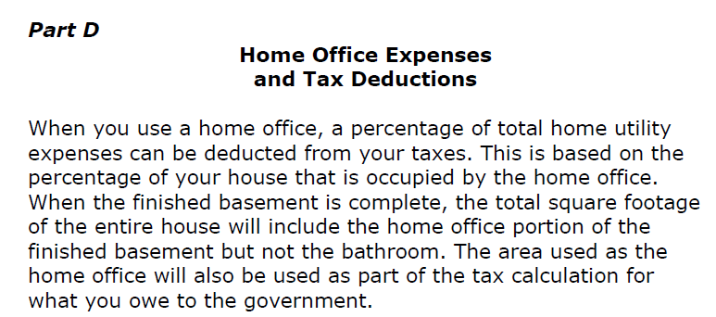

Slide 37
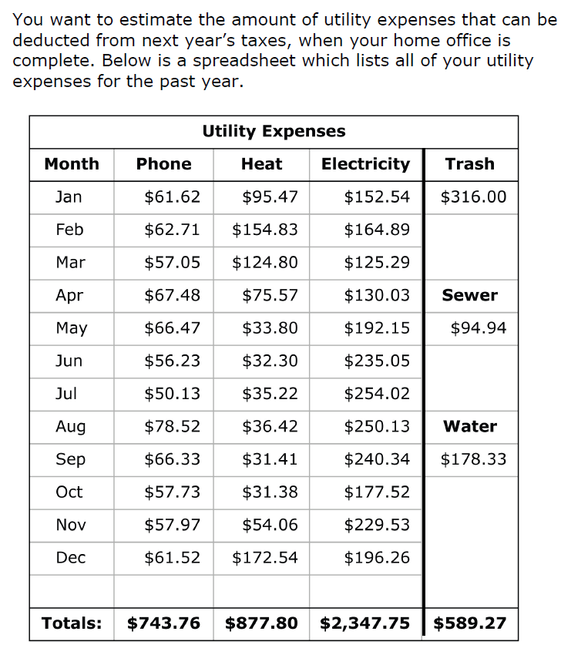

Slide 38
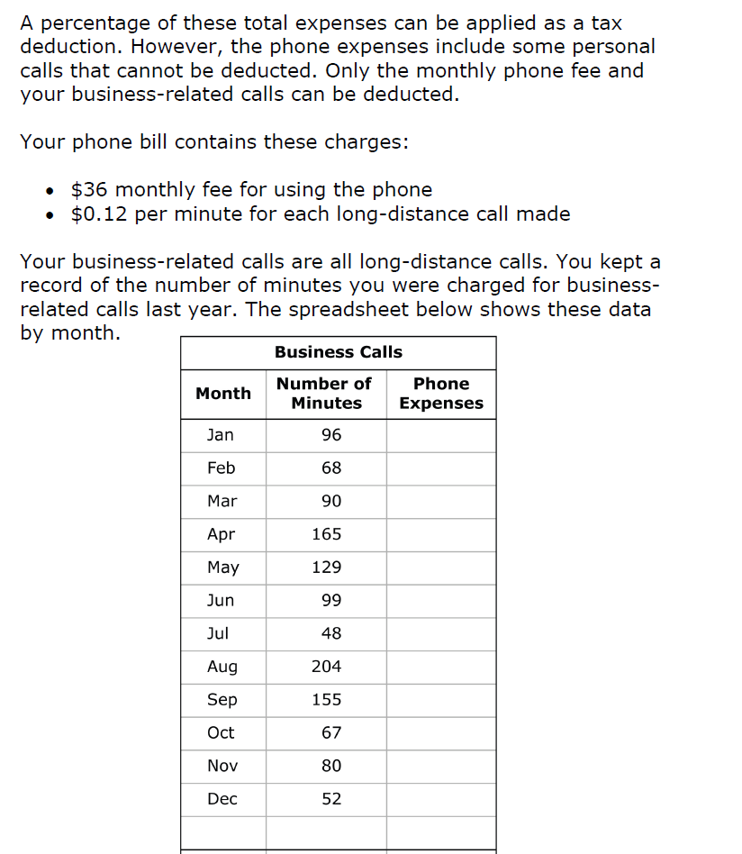

Slide 39
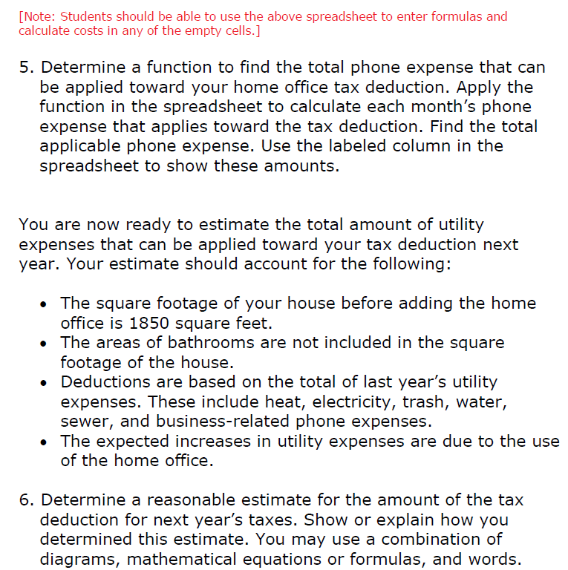

Slide 40
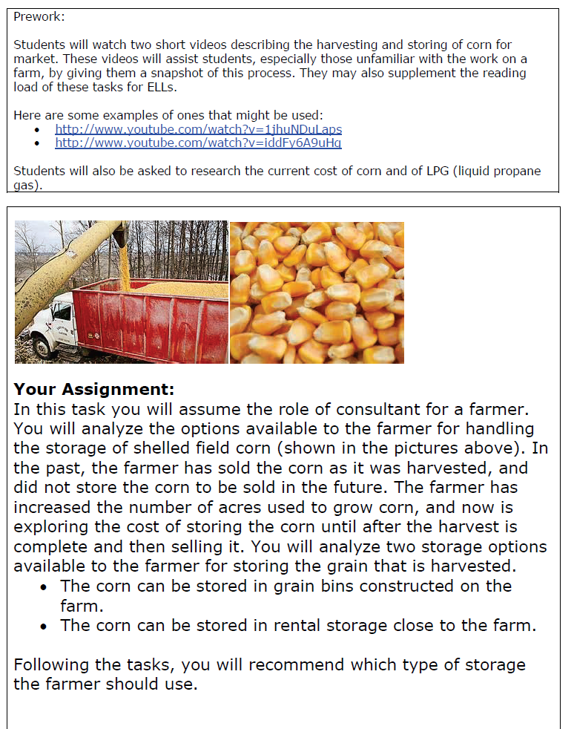

Slide 41
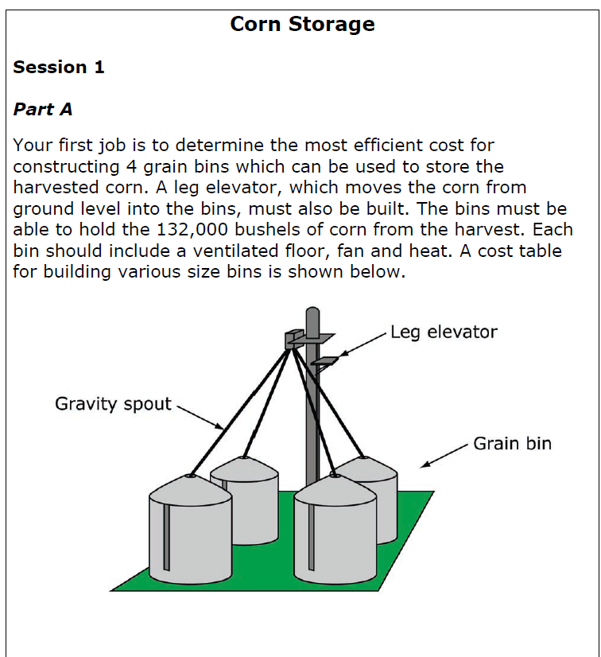

Slide 42
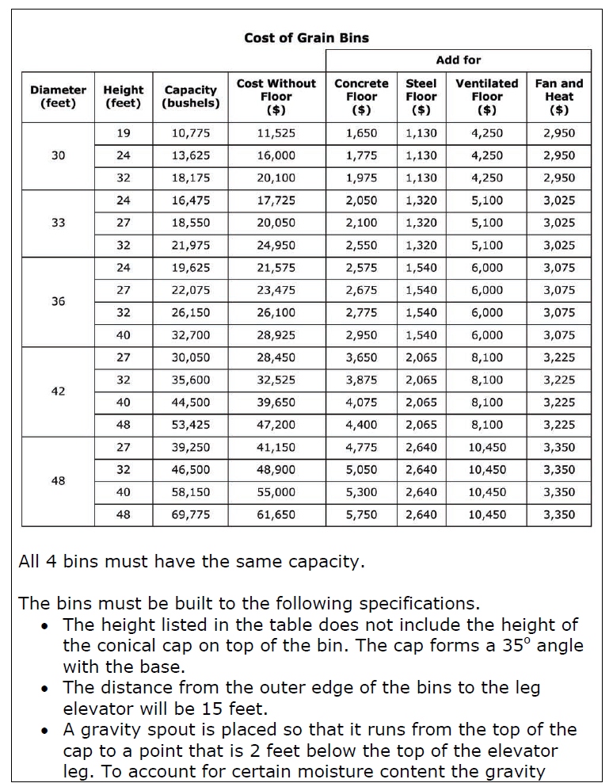

Slide 43
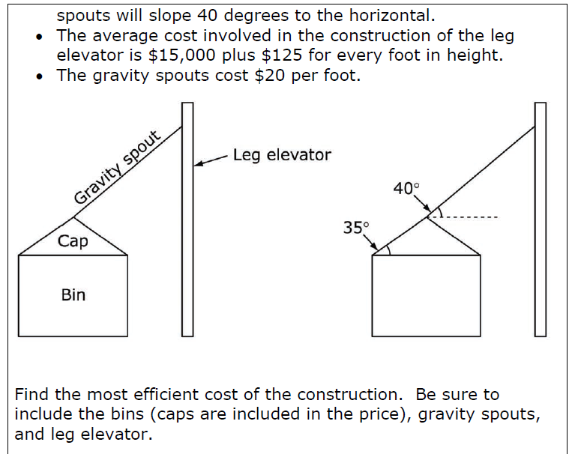

Slide 44
Reference
Herman, J. L., Aschbacher, P. R., & Winters, L. (1992). Ensuring reliable scoring. A practical guide to alternative assessment (pp. 80-94). Alexandria, VA: ASCD

Slide 45
PLENARY ASSESSMENT OF LEARNING IN THE CLASSROOM: Rubrics

Slide 46
The scoring of assessments
This might not be a problem in scoring MCs, but CRs and Open-Ended PAs can prove a problem.
The most popular solution is the Rubric.
A scoring rubric is a set of ordered categories to which a given piece of work can be compared.
Scoring rubrics specify the qualities or processes that must be exhibited in order for a performance to be assigned a particular evaluative rating.

Slide 47
Parts of a Rubric
A scale of points representing a continuum of quality.
Descriptors containing standards and criteria to judge the performance of the work.
Criteria for the conditions associated with successful performance.
Standards for describing how well criteria must be met

Slide 48
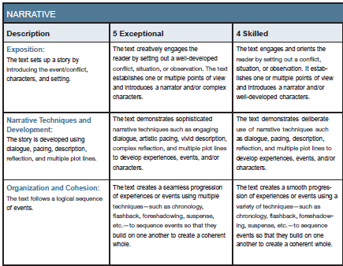
Performance Level Labels
Descriptors
Criteria

Slide 49
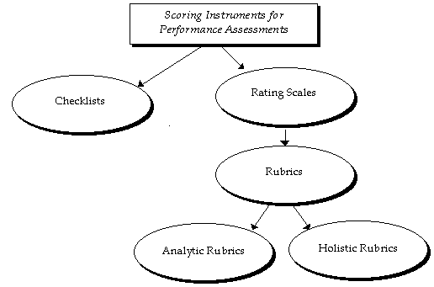
From checklist to rubric

Slide 50
Types of Rubrics

Slide 56
Developing a Rubric
Identify the type and purpose of the Rubric
Identify Distinct Criteria to be evaluated
Determine your levels of assessment
Describe each level for each of the criteria, clearly differentiating between them –
Involve learners in development and effective use of the Rubric
Pre-test and retest your rubric

Slide 57
Developing a Rubric
Identify the type and purpose of the Rubric - Consider what you want to apply assess/evaluate and why.
Identify Distinct Criteria to be evaluated - Develop/reference the existing description of the course/assignment/activity and pull your criteria directly from your objectives/expectations. Make sure that the distinction between the assessment criteria are clear.

Slide 58
Developing a Rubric
Determine your levels of assessment - Identify your range and scoring scales. Are they linked to simple numeric base scores? Percentages? Grades?
Describe each level for each of the criteria, clearly differentiating between them - For each criteria, differentiate clearly between the levels of expectation. Whether holistically or specifically, there should be no question as to where a product/performance would fall along the continuum of levels.

Slide 59
Developing a Rubric
Involve learners in development and effective use of the Rubric - Learner engagement in the initial design and development will help to increase their knowledge of expectations and make them explicitly aware of what and how they are learning and their responsibility in the learning process.

Slide 60
Developing a Rubric
Pre-test and retest your rubric - A valid and reliable rubric is generally developed over time. Each use with a new group of learners or a colleague provides an opportunity to tweak and enhance it.

Slide 61
Performance Labels http://www.music.miami.edu/assessment/rubricsDescripts.html

Slide 62
Basic | Proficient | Advanced
Beginner | Amateur | Professional
Beginner | Intermediate | Advanced
Fundamental | Competent | Exceptional
Immature | Maturing | Advanced
Level 1 | Level 2 | Level 3
Needs Improvement | Developing | Exceptional
Needs Improvement | Meets Expectations | Exceeds Expectations
Needs Work | Acceptable | Excellent
Needs Work | Adequate | Strong
Neophyte | Learner | Artist
No | Sometimes | Yes
Novice | Apprentice | Expert

Slide 63
Basic | Acceptable | Artist | Always
Basic | Proficient | Accomplished | Advanced
Beginning | Developing | Accomplished | Exemplary
Beginning | Developing | Accomplished | Exemplary
Developing | Basic | Proficient | Advanced
Fundamental | Competent | Advanced | Exceptional
Immature | Maturing | Advanced | Exemplary
In Progress | Basic | Proficient | Advanced
Incomplete | Partially Proficient | Proficient | Exemplary
Needs Improvement | Satisfactory | Good | Exemplary
Needs Work | Adequate | Strong | Excellent

Slide 64
No Understanding | Beginning | Proficient | Accomplished
Not Yet | Successful | Highly Successful | Outstanding
Not Yet | Almost | Meets Standard | Exceeds Standard
Novice | Partially Proficient | Proficient | Advanced
Novice | Adequate | Developed | Exceptional
Rudimentary | Skilled | Advanced | Exemplary
Rudimentary | Skilled | Accomplished | Advanced
Seldom | Sometimes | Usually | Always
Starting | Basic | Proficient | Advanced
Undeveloped | Developing | Developed | Advanced
Unmet | Met | Advanced | Exemplary
Unprepared | Developing | Participating | Accomplished
Unsuitable | Unmotivated | Participating | Prominent

Slide 65
Beginning | Basic | Proficient | Advanced | Exceptional
Immature | Beginning | Developing | Acceptable | Professional
Neophyte | Beginning | Proficient | Advanced | Exceptional
No Concept | Beginning | Developing | Advancing | Accomplished
Not Introduced | Beginning Level | Functional | Partial Fluency | Independent
Poor | Fair | Good | Very Good | Excellent
Poor | Fair | Average | Good | Excellent
Poor | Fair | Good | Excellent | Superior

Slide 66
Beginner | Adv. Beginner | Intermediate | Adv. Intermed. | Advanced | Superior
Immature | Basic | Developing | Proficient | Accomplished | Advanced
No Concept | Many Flaws | Some Flaws | Few Flaws | Outstanding | Flawless
No Concept | Beginning | Basic | Developing | Proficient | Advanced
No Effort | Below Average | Low Average | High Average | Above Average | Superior
Unable | Beginning | Basic | Proficient | Advanced | Exceptional
Unable | Beginning | Developing | Proficient | Advanced | Exceptional

Slide 67
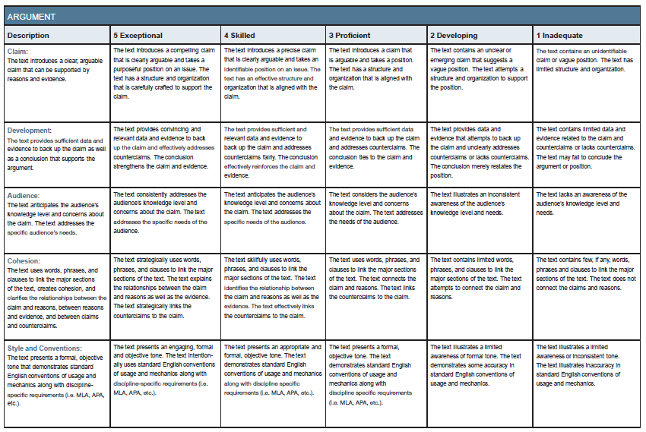
SAMPLE RUBRICS

Slide 68
