Slide 1
Tobago Workshop on Educational Assessment
Day 9, Session 1: Gwendolyn Ahyoung &
Avril Fox-Pooran

Slide 2
Day 9 Formative and Diagnostic Assessments
PLENARY: From Evidence to Action in Formative
Assessment
PLENARY: Assessment to Improve Reading
Response to Intervention Models
PLENARY: Diagnostic Assessments – Why important
for Tobago

Slide 3
From evidence to action
FORMATIVE ASSESSMENT

Slide 4
Background Information
Researchers believe that in this new Media Age, there is a need to rethink assessment because of changing texts and audiences, and how students now have to react with a wide range of texts (Silva, 2008).
Afflerbach (2007) makes the case that simultaneously employing a variety of assessments is the only sure means to understand where children are in their learning, and how best to inform their progress.

Slide 5
Purposes of assessments
Every assessment is designed to measure something.

Slide 6
USES
VAST MAJORITY
OF ASSESSMENTS
To inform and improve instruction (internal to the classroom - formative)
To screen/identify (for interventions)
To measure outcomes for evaluation or school improvement planning

Slide 7
Quality Assessment of Reading and Writing
The Standards for the Assessment of Reading and Writing aims to improve the quality of assessment by providing standards to guide decisions about assessing the teaching and learning of literacy in 21st century classrooms.
It requires gathering information and setting conditions so that the classroom, school and community become centers of inquiry.
Students, teachers and other stakeholders (parents) can examine their learning – individually and collaboratively – and find ways to improve their practice.
Standards for Educational and Psychological Testing (AERA, et al, 1999)

Slide 8
Barriers to Successful Implementation
Lack of time
Limited assessment literacy skills
Interpreting and communicating results to students and parents
Providing descriptive feedback
Diagnosing needs for particular intervention strategies
Implementing Strategies

Slide 9
Suggestions for Successful Implementation
Use of high quality assessment tools that match learning targets
Tools are closely aligned to the curriculum and give detailed feedback
Linkage of assessment with curriculum and instruction
Student involvement linked to expectations for learning
Effective use of results
Design systems for the more integrated involvement of teachers and professional development opportunities.

Slide 10
Definition
Formative assessment is a process and/or a set of strategies that teachers and students use to gather information during the learning process and to make adjustments accordingly.

Slide 11
Differences between formal and informal formative assessment practices Purpose: Reduce the Gap Ruiz-Primo & Furtak, 2007)
FORMAL
INFORMAL
Gathering (through quizzes and embedded assessments
Interpreting (reading student work, providing written comments to all students)
Acting (written lesson plans)
Eliciting (asking students to formulate explanations or to provide evidence)
Recognizing (repeating or revoicing students’ responses)
Using (ask students to elaborate and explain)

Slide 12
Assessment Data
Converted into usable, actionable information for decision-making

Slide 13
Major forces in assessing students
1. How to assess
Detecting errors
Detecting assumptions
Formulating questions
Developing criteria
Developing analogies
Using models/exemplars/rubrics

Slide 14
Major forces in assessing students
Data collection takes place individually or
in groups.
2. When to assess
At transition points (in short cycles)
Use what is learned to create options and choices (keep instruction at pace with student needs and learning styles)

Slide 15
Formative Data
Teachers need to learn to use formative data to make better choices
Formative data is analyzed; course corrections made
Accurate choices lead to proficiency and higher levels of performance on the final performance

Slide 16
Standards and Benchmarks
Assessments must be aligned with standards and benchmarks.
Start with the assessment
Work backward to the benchmark.

Slide 17
Using the Data
Not about individualizing instruction and learning
But about planning accurately for instruction
Using differentiating strategies, BASED ON THE DATA
Assessment becomes formative when the evidence is actually used to adapt the teaching to meet student needs (Black & Wiliam, 1998).

Slide 18
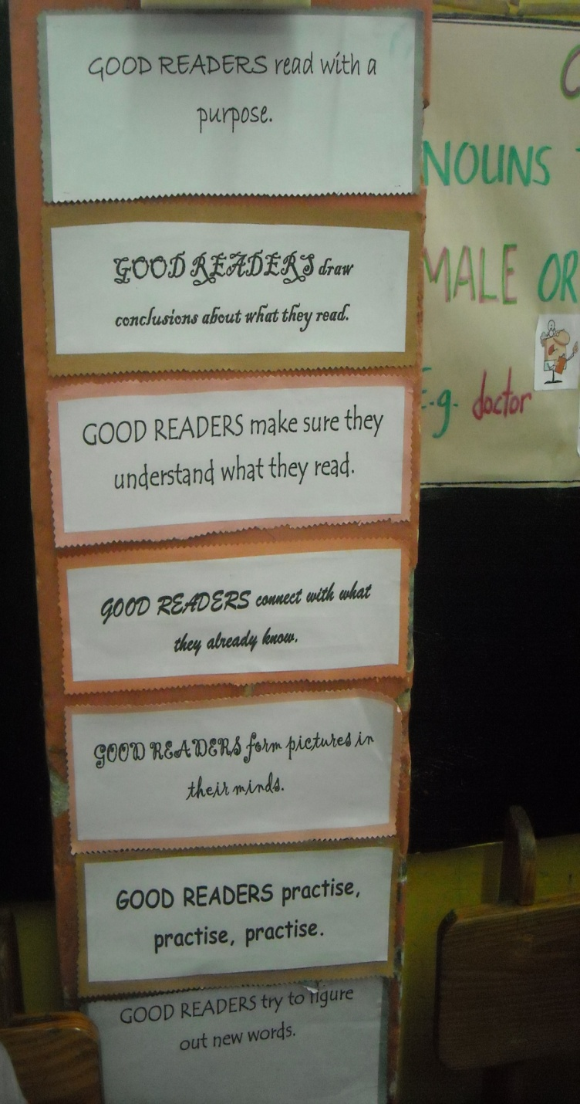
Integration of Formative Assessment in the Teaching of Reading Comprehension

Slide 19
Teacher Judgments
Teacher Observations
Use of Checklists
Rubrics
Questioning Techniques
Providing Quality Feedback

Slide 20
Questioning Strategies for Comprehension
Focus on literal and inferential comprehension
of text
1. Initiate-Respond-Evaluate
Teachers ask questions
Students respond
Teachers evaluate students’ responses

Slide 21
Questioning Strategies
Helps students to develop strategic
approaches to reading
2. K-W-L Strategy (Ogle, 1986)
Students ask –
What do I know?
What do I want to learn?
What did I learn?

Slide 22
3. Question-Answer-Relationship (QAR) Raphael & Wonnacott, 1985
In-the-Text Questions
In-My-Head Questions
Right there questions
e.g. Who is the main character?
Think and Search questions
e.g. How did the character return home?
Author and you Questions
e.g. Would you have made the same choice the character made?
On-My-Own Question
e.g. Do you know what it is like to feel jealous?

Slide 23
4. Questioning the Author (Beck et al., 1997)
Develop in students good questioning ability
(ask authors of the text)
Leads to critical reading

Slide 24
Bloom’s Revised Taxonomy of Thinking Questions (Bloom, 1956)
Assessing first with literal comprehension questions
Assessing second with evaluative comprehension questions (critical appraisal)
Higher order to Lower order
Creating
Evaluating
Analysing
Applying
Understanding
Remembering

Slide 25
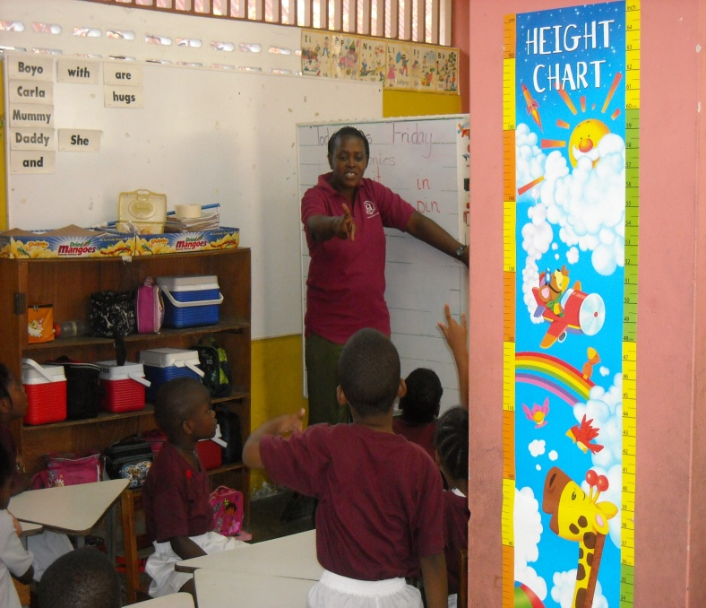
FEEDBACK (Paul Black et al., 2003)
An Essential Part of Formative Assessment

Slide 26
Characteristics of Formative Feedback
Focus on an observed skill, behaviour or knowledge level
Compares the observation to an established standard or learning objective
Provides an example of how to improve
Non-judgmental or non-evaluative
Based on direct information or reliable information
Timely; Expected by the learner; Genuine
Occurs on a regular basis
Specific, not general

Slide 27
Quality of Feedback influences quality of learning (Black & Wiliam, 1998)
Students know how well they are progressing – informed of their strengths and areas to improve
Know what they need to do to improve

Slide 28
An Effective Formative Assessment System (Hattie & Timperley, 2007)
Feed-up (Where am I going?)
Feedback (How am I doing?)
Feed Forward (Where am I going next?)

Slide 29
Feedback Types (by complexity) Shute (2007, 2008)
Types
Description
No feedback …………..
Verification …………….
Correct response …….
Try-again ……………….
Error-flagging …………
Elaborated ……………..
No indication as to the correctness of the answer
Right or wrong (overall percentage)
Only informs the learner of the correct answer
Repeat-until correct
Highlights errors in solution without giving the correct answer
Explaining why a specific response was correct (allows the learner to review part of the instruction)

Slide 30
Feedback Types
Elaborated Feedback
Description
Attribute Isolation
Topic-contingent
Response-contingent
Hints/cues/prompts
Bugs/misconceptions
Informative tutoring
Presents information on skill being studied
Might entail re-teaching material
Describes why the answer is right/wrong
Strategic hint on what to do next or a demonstration
Provides information about the learner’s specific errors or misconceptions
Verification feedback, error-flagging and strategic hints on how to proceed

Slide 31
Strategies & the integration of formative assessment tools are intended to enhance the following Comprehension Skills
Story structure
Sequence of events
Main Idea/Details
Noting details
Identifying Character Traits
Compare and contrast
Categorize and classify
Fact and Opinion
Cause and Effect
Fantasy and Reality
Drawing Conclusions
Making Judgments
Identifying text features
Organizational Text Structure
Vocabulary Development

Slide 32
Students are exposed to a variety of Text types/Genres
Picture books
Short stories
Folk stories/fairy tales
Myths & legends (appropriate to culture)
Novels
Poetry
Biographies & autobiographies
Letters to the editor, magazine articles
Excerpts from books for different purposes
Published work written by students in class
Digital texts

Slide 33
The Reading-Writing Connection

Slide 34
Assessing Reading through Writing
Readers access other people’s ideas, knowledge and points of view from print or other forms of media.
Writers communicate their ideas, knowledge and points of view through writing.
Link reading and writing skills by employing many of the same strategies for making meaning – e.g.,
Activating prior knowledge
Making predictions
Monitoring comprehension
Olson, 2003

Slide 35
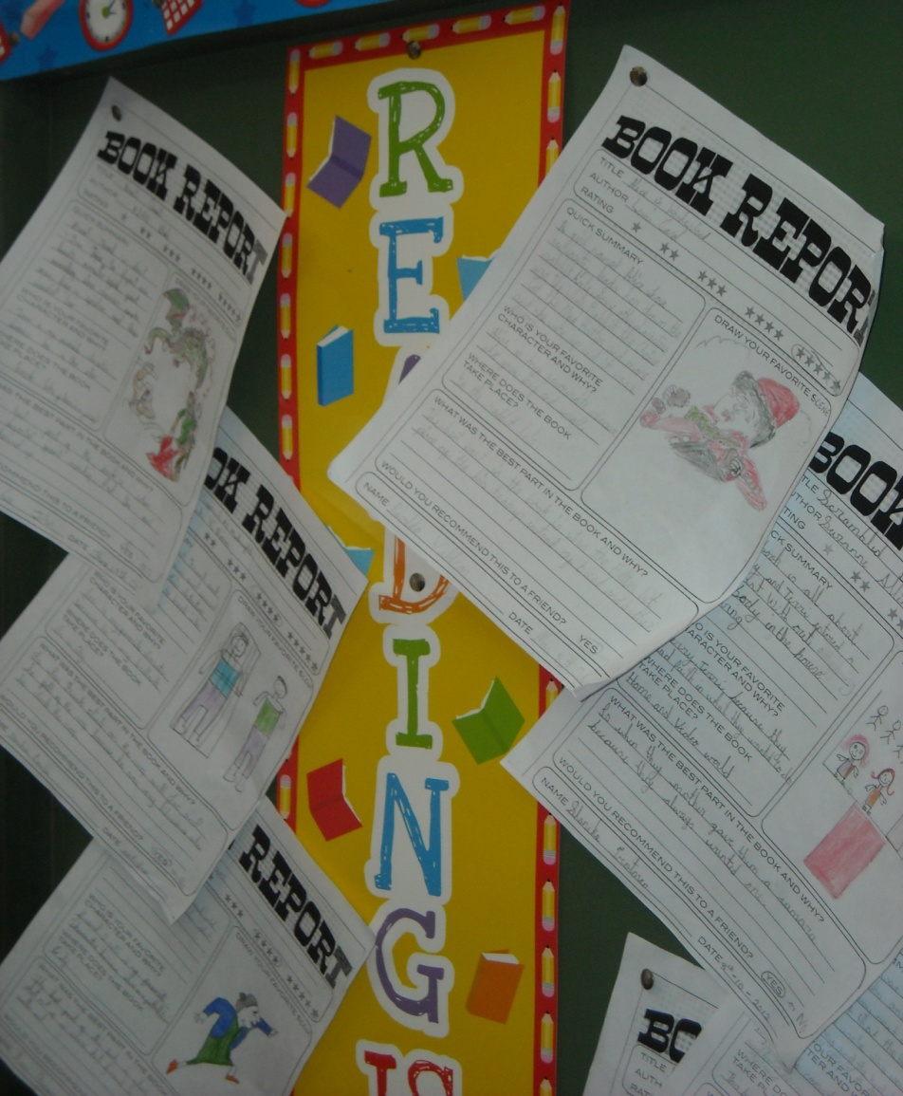
Reading/Writing Activity

Slide 36

Diagnostic Assessment
Day 9 Session 3

Slide 37
Pre-assessments
DATA can come from:
Summative assessment from the
previous activity
Short assessments that focus on key
knowledge and concepts

Slide 38
Types of Diagnostic assessments
Informal procedures
Observing responses to specific tasks
Examining work products
Asking questions about their understanding or strategies
Formal procedures
Oral diagnostic tests that identify, describe and measure students’ strengths and weaknesses

Slide 39
Screening for Reading Problems
Testing
Purpose
To identify those students at risk for reading difficulties
To identify those students on track for successful reading outcomes
THEN – to make instructional decisions
Administered to all students at least 3 times per year
Directly measure students’ proficiency on the essential elements of reading – letter knowledge, phonics, phonological awareness, fluency, vocabulary and comprehension

Slide 40
Results/Follow-up
Design learning objectives aligned with the educational needs of their students
Actively involve students in the assessment process and provide prompt feedback
Application in new situations of skills and knowledge gained by learners during assessment

Slide 41
EXAMPLE OF A SCREENING ASSESSMENT
Dynamic Indicators of Basic Early Literacy Skills (DIBELS)
Assesses for Phonemic Awareness and Fluency
Formative in nature
Age group: K-3

Slide 42
EXAMPLE OF A SCREENING ASSESSMENT
Basic Achievement Skill Inventory
Measures Math, Reading and Language Skills for children and adults
Aid in diagnosing learning disabilities
Understanding specific areas of strength and weakness and for measuring progress
Use the survey version to determine which level of the BASI Comprehensive Test to administer
Organised into four grade specific levels
Six timed subsets (10 minutes): Vocabulary, Spelling, Language Mechanics, Reading Comprehension

Slide 43
EXAMPLE OF A SCREENING ASSESSMENT
3 oral diagnostic tests – spelling, reading and math fluency
Identifies and describes students’ strengths and weaknesses
Investigates over-under achievement and examines patterns of intra-individual discrepancies among cognitive or achievement areas.
Time to administer: 60-70 minutes
Age group: K-12
Diagnostic/Formative
Woodcock Johnson III Test of Achievement

Slide 44
Reflection Questions
Beliefs
What are our core beliefs about how students learn?
What is the evidence base that supports these beliefs?
Structures
What structures do we have in our school to support teacher collaboration?
Do we ensure that teacher meetings always focus on teaching and learning?
Building Expertise
How do we build in-house expertise and create learning progressions for reading, academic language and other content areas?

Slide 45
Reflection Questions
Process and Content
Have we made an inventory of formative assessment strategies? How effectively do we use these strategies in our classrooms?
Do we meet regularly to focus on interpreting evidence from formative assessment to increase our interpretive skills?
Do we need to focus on providing feedback to students and pooling pedagogical content knowledge in order to develop the most effective strategies?
Additional Professional Support
What kind of opportunities do we have to go beyond the school for in-depth professional development?
Do we have a professional library?

Slide 46
Selected References
Afflerbach, P. (2007). Understanding and Using Reading Assessment, K-12, International Reading Association Inc.
Bailey, A.L. & Heritage, M. (2008). Formative assessment for literacy: Building reading and academic language skills across the curriculum, Corwin Press.
Black, P. & Wiliam, D. (1998). Assessment and classroom learning. Assessment in Education: Principles, Policy & Practice, 5(1), 7-74.
Black, P. et al., (2003). Assessment for Learning: Putting it into Practice, Open University Press, Berkshire, England.
Bloom, B.S. (1956). Taxonomy of educational objectives, Handbook 1: The cognitive domain, New York: David McKay
Hattie, J. Timperley, H. (2007). The Power of Feedback, Review of Educational Research, 77 (1), 81-112.

Slide 47
Selected References
Olson, C. (2003). The reading/writing connection: Strategies for teaching and learning in the secondary classroom. Boston: Allyn & Bacon.
Ruiz-Primo, M.A. & Furtak, E.M. (2007). Exploring teachers’ informal formative assessment practices and students’ understanding in the context of scientific inquiry, Journal of Research in Science Teaching, 44 (1), 57-84.
Shute, V. (2007). Focus on Formative Feedback, Research and Development.

